Slide 1

Rules of Thumb for Information Acquisition from Large and Redundant Data
Version April 21, 2011
Wolfgang Gatterbauer
33rd European Conference on Information Retrieval (ECIR'11)
Database group
University of Washington
http://UniqueRecall.com

Slide 2
Information Acquisition from Redundant Data
Pareto principle (80-20 rule)
20% causes
80% effect
e.g. business
clients
sales
e.g. software
bugs
errors
e.g. health care
patients
HC resources
Information acquisition
? 20% data
(instances)
? 80% information
(concepts)
e.g. web harvesting
web data
web information
e.g. words in a corpus
all words
different words
e.g. used first names
individual names
different names
  Motivating question:
  Can we learn 80% of the information,
  by looking at only 20% of the data?

Slide 3
Information Acquisition from Redundant Data
Information Acquisition
Information
Dissemination
Information Retrieval,
Information Extraction
Information
Integration
A_{u}
A
B
B_{u}
"Unique"
information
Available
Data
Retrieved and
extracted data
Acquired
information
Redundancy
distribution k
Recall r
Expected sample
distribution k
Expected unique recall r_{u}
Three assumptions
no disambiguity in data
random sampling w/o replacement
very large data sets

Slide 4
Outline
  A horizontal sampling model
  The role of power-laws
  Real data & Discussion

Slide 5
A Simple Balls-and-Urn Sampling Model
frequency of i-th most often appearing information (color)
Redundancy k_{i}
Redundancy k_{i}
6
Data
6
Sampled Data
(# balls: a=15)
(# balls: b=3)
5
5
4
4
3
3
2
2
1
1
1
2
3
4
5
1
2
3
4
5
Information i
Sampled Information i
(# colors: a_{u}=5)
(# Colors: b_{u}=2)
Redundancy
Distribution k
k=(6,3,3,2,1)
  Recall r
  r=3/15=0.2
  Unique recall r_{u}=2/5=0.4
  Sample Redundancy
  distribution k=(2,1)

Slide 6
A model for sampling in the Limit of large data sets
a=15
a=30
a→∞
6
6
6
5
5
5
4
α₃=0.4
4
α₃=0.4
4
α₃=0.4
3
3
3
2
2
2
1
1
1
1
2
3
4
5
1
2
3
4
5
6
7
8
9
10
1
2
3
4
5
k=(6,3,3,2,1)
k=(6,6,3,3,3,3,2,2,1,1)
α=(0.2,0.2,0.4,0,0,0.2)
k₂₋₃=3
k₃₋₆=3
...
vertical perspective
horizontal perspective

Slide 7
The Intuition for constant redundancy k
lim
r=0.5
a→∞
Unique recall
k=const=3
≈ Indep. sampling with p=r
3
Δ₂
Expected sample distribution
2
1
0
r_{u}
1
≈ Binomial distribution
Δ₂=(3 choose 2)0.5²(1-0.5)¹=0.375
r_{u} = 1-(1-0.5)³=0.875

Slide 8
The Intuition for arbitrary redundancy distributions
Redundancy k
Stratified sampling
α₆= 0.2
r=0.5
lim
a→∞
6
5
4
α₃=0.4
3
α₂= 0.2
ω₂
2
α₁= 0.2
1
0
0.2
0.6
0.8
1
r_{u}= α₆[ 1-(1-r)⁶ ] + α₃[ 1-(1-r)³ ] + α₃[ 1-(1-r)² ] + α₁[ 1-(1-r)¹ ]

Slide 9
A horizontal Perspective for Sampling
r=0.5
Expected sample
redundancy k₁=3
a_{u}=5
a_{u}=20
Horizontal layer of
redundancy ω₁=0.8
a_{u}=100
a_{u}=1000
b_{u}=800

Slide 10
Unique Recall for arbitrary redundancy distributions
10

Slide 11
Outline
  A horizontal sampling model
  The role of power-laws
  Real data & Discussion

Slide 12
Three formulations of Power law distributions
redundancy
frequency α_{k}
complementary
cumulative
frequency η_{k}
redundancy k_{i}
Zipf-Mandelbrot
Power-law probability
Pareto
Zipf [1932]
Stumpf et al. [PNAS’05]
Mitzenmacher [IM’04]
Commonly assumed to be different represen-
tations of the same distribution
Adamic [TR’00]
Mitzenmacher [Internet Math.’04]
12

Slide 13
Unique Recall with Power laws
log-log plot
For γ=1
13

Slide 14
Unique Recall with Power laws
For γ=1
Rule of Thumb 1: When sampling 20% of data from a Power-law distribution, we expect to learn less than 40% of the information
14

Slide 15
Invariants under Sampling
Given our model: Which redundancy distribution remains invariant under sampling?
15

Slide 16
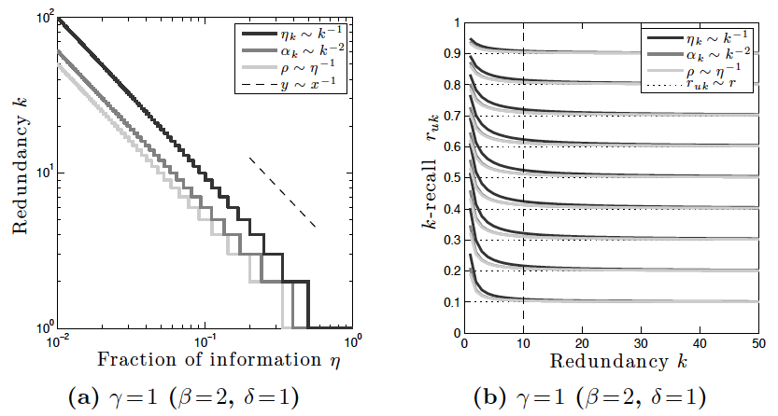
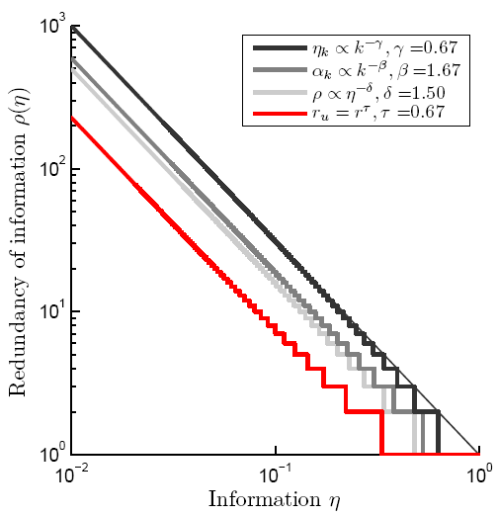
Invariant is a power-law! Hence, the tail of all power laws remains invariant under sampling
r_{uk}=ω_{k}/η_{k}
16

Slide 17
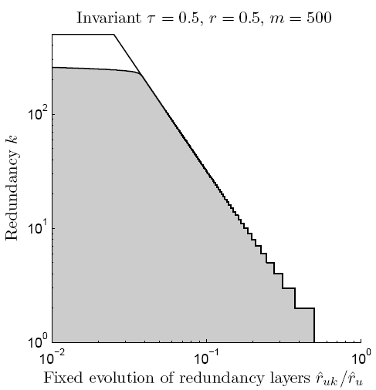
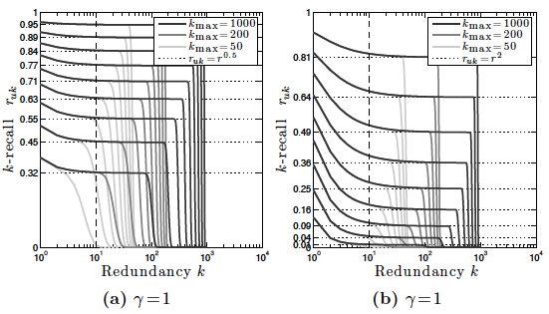
Also, the power law tail breaks in
Rule of Thumb 2: When sampling data from a Power-law then the core of the sample distribution follows
17

Slide 18
Outline
  A horizontal sampling model
  The role of power-laws
  Real data & Discussion

Slide 19
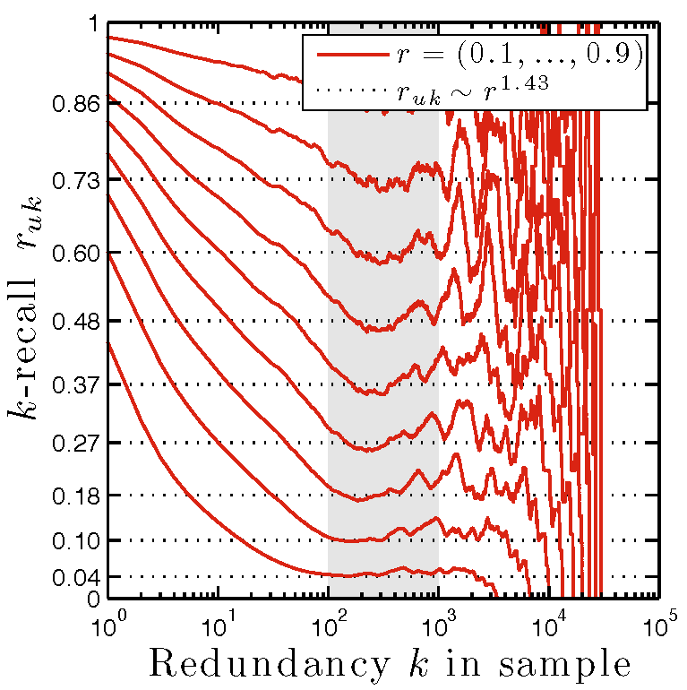
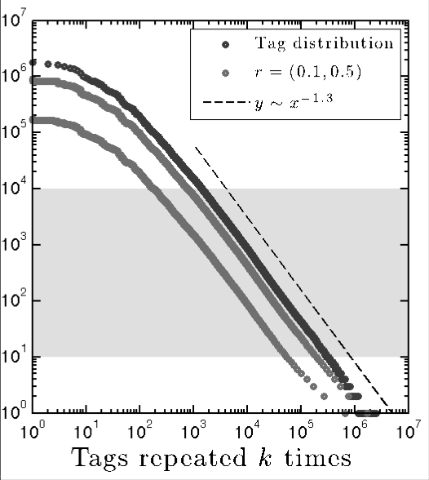
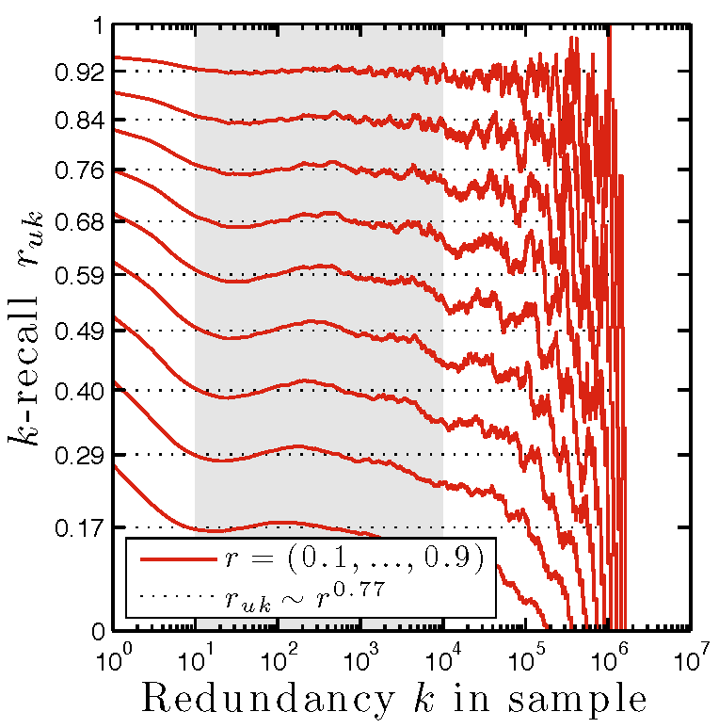
Sampling from Real Data
Rule of Thumb 2:
works, but only for small area
Incoming links for one domain
Rule of Thumb 1:
not good!
Rule of Thumb 2:
works!
Tag distribution on delicious.com
Rule of Thumb 1:
perfect!

Slide 20
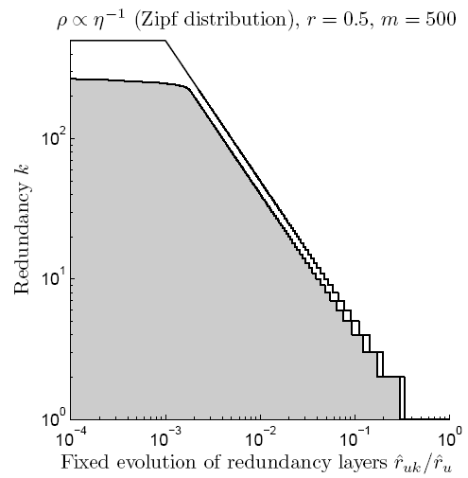
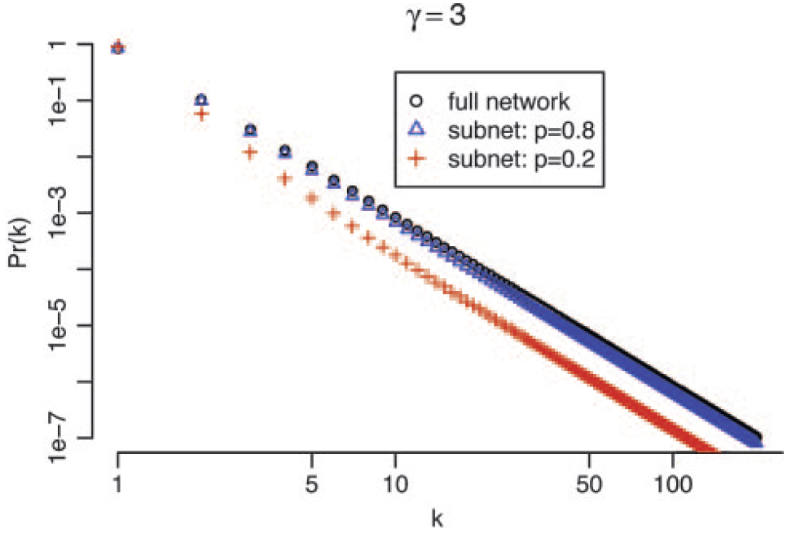
Theory on Sampling from Power-Laws
Stumpf et al. [PNAS’05]
This paper
"Here, we show that random subnets sampled from scale-free networks are not themselves scale-free."
"Here, we show that there is one power-law family that is invariant under sampling, and the core of other power-law function remains invariant under sampling too.

Slide 21
Some other related work
Population sampling
goal: estimate size of population
e.g. mark-recapture animal sampling
sampling of small fraction w/ replacement
Downey et al. [IJCAI’05]
urn model to estimate the probability that extracted information is correct.
random sampling with replacement
Ipeirotis et al. [Sigmod’06]
decision framework to search or to crawl
random sampling without replacement with known population sizes
Bar-Yossef, Gurevich
[WWW’06]
biased methods to sample from search engine's index to estimate index size
Stumpf et al. [PNAS’05]
show that random subnets sampled from scale-free networks are not scale-free

Slide 22
Summary 1/2
Inf. Acquisition
Inf. Dissemination
IR & IE
Inf. Integration
A simple model of
information acquisition
from redundant data
A_{u}
A
B
B_{u}
no disambiguity
random sampling
w/o replacement
Information
Available
Data
Retrieved
Data
Acquired
information
Redundancy
distribution k
Recall r
Sample
distribution k
Unique recall r_{u}
r_{u}(r)
Normalized
Redundancy
distribution α
Full analytic
solution
large data
r_{uk}(r)
r_{uk}=ω_{k}/η_{k}

Slide 23
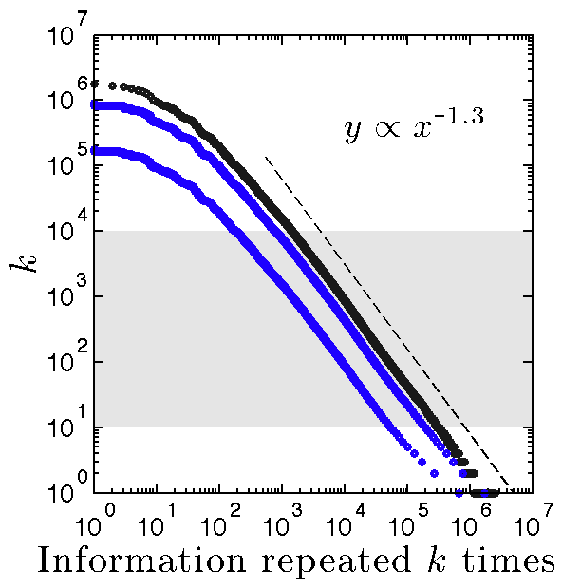
Summary 2/2
3 different power-laws
Unique recall for power-laws
Rule of thumb 1:
80/20 → 40/20
sensitive to exact
power-law root
Invariant distribution
Sampling from power-laws
Rule of thumb 2:
power-law core
remains invariant
r_{uk} ≈ r^{γ}
http://uniqueRecall.com

Slide 24
backup

Slide 25
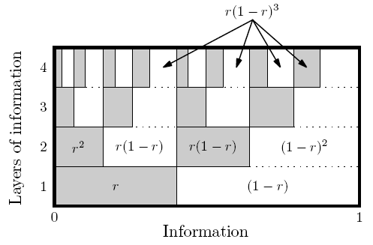
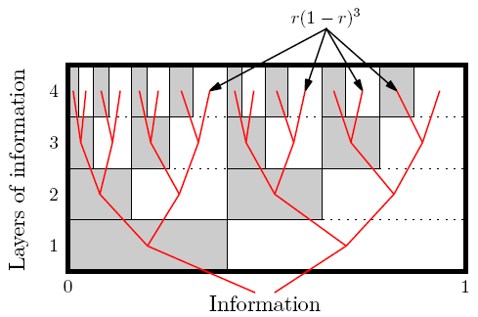
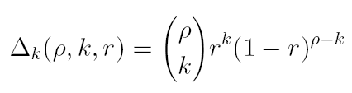
Geometric interpretation of Δ_{k}(ρ, k, r)
BACKUP

Slide 26
Information Acquisition from Redundant Data
  3 pieces of data, containing 2 pieces of (“unique”) information*
Data
(instances)
Information
(concepts)
e.g. used first names in a group
individual names / different names
e.g. words of a corpus:
word appearances / vocabulary
e.g. web harvesting:
web data / web information
  Motivating question:
  Can we learn 80% of the information,
  by looking at only 20% of the data?
Capurro, Hjørland [ARIST’03]
  *data interpreted as redundant representation of information

