Slide 1
Factorized Graph Representations for semi-supervised learning from sparse data
$$∏$$
$$∑$$
Krishna Kumar, Paul Langton, Wolfgang Gatterbauer
SIGMOD 2020, Thursday, June 18, 2020, R16: 3:00 – 4:30 pm PT
Slides: https://github.com/northeastern-datalab/factorized-graphs/
DOI: https://doi.org/10.1145/3318464.3380577
Data Lab: https://db.khoury.northeastern.edu
This work is licensed under a Creative Commons Attribution-Noncommercial-Share Alike 4.0 International License. See https://creativecommons.org/licenses/by-nc-sa/4.0/ for details

Slide 2
Learning from few labels
with algebraic amplification
Semi-supervised learning exploit relationships on label distribution (e.g. smoothness in networks)
Algebraic amplification leverage algebraic properties of the algorithm to amplify signal in sparse data
$$∏$$
$$∑$$
weak labels
labeled
labeled
unlabeled data
unlabeled data
Weak (or distant) supervision
add noisier labels (e.g. heuristics, or external knowledge base)
Algebraic cheating this requires "nice" algebraic properties; we may have to modify the algorithms ☺

Slide 3
Our focus today: Node classification in undirected graphs
Preference among node classes
$$⇒$$
Compatibilities between classes
0.2
0.6
0.2
$H$=
0.6
0.2
0.2
class 1 (blue)
class 2 (orange)
0.2
0.2
0.6
Σ=1
class 3 (green)
orange prefers blue (and v.v.)
green prefers green

Slide 4
Our focus today: Node classification in graphs
Preference among node classes
$$⇒$$
Compatibilities between classes
most of which are unlabeled
not known to us ☹
?
?
?
0.2
0.6
0.2
?
?
0.6
0.2
0.2
$H$=
?
0.2
0.2
0.6
?
?
Σ=1
?
linearized belief propagation, semi-supervised learning
Goal: Classify the remaining nodes: Propagate those compatibilities
Goal: Classify the remaining nodes: Estimate & propagate those compatibilities
State-of-the-art: Heuristics / domain experts We will estimate (learn) from sparse data

Slide 5
How well does it work?

Slide 6
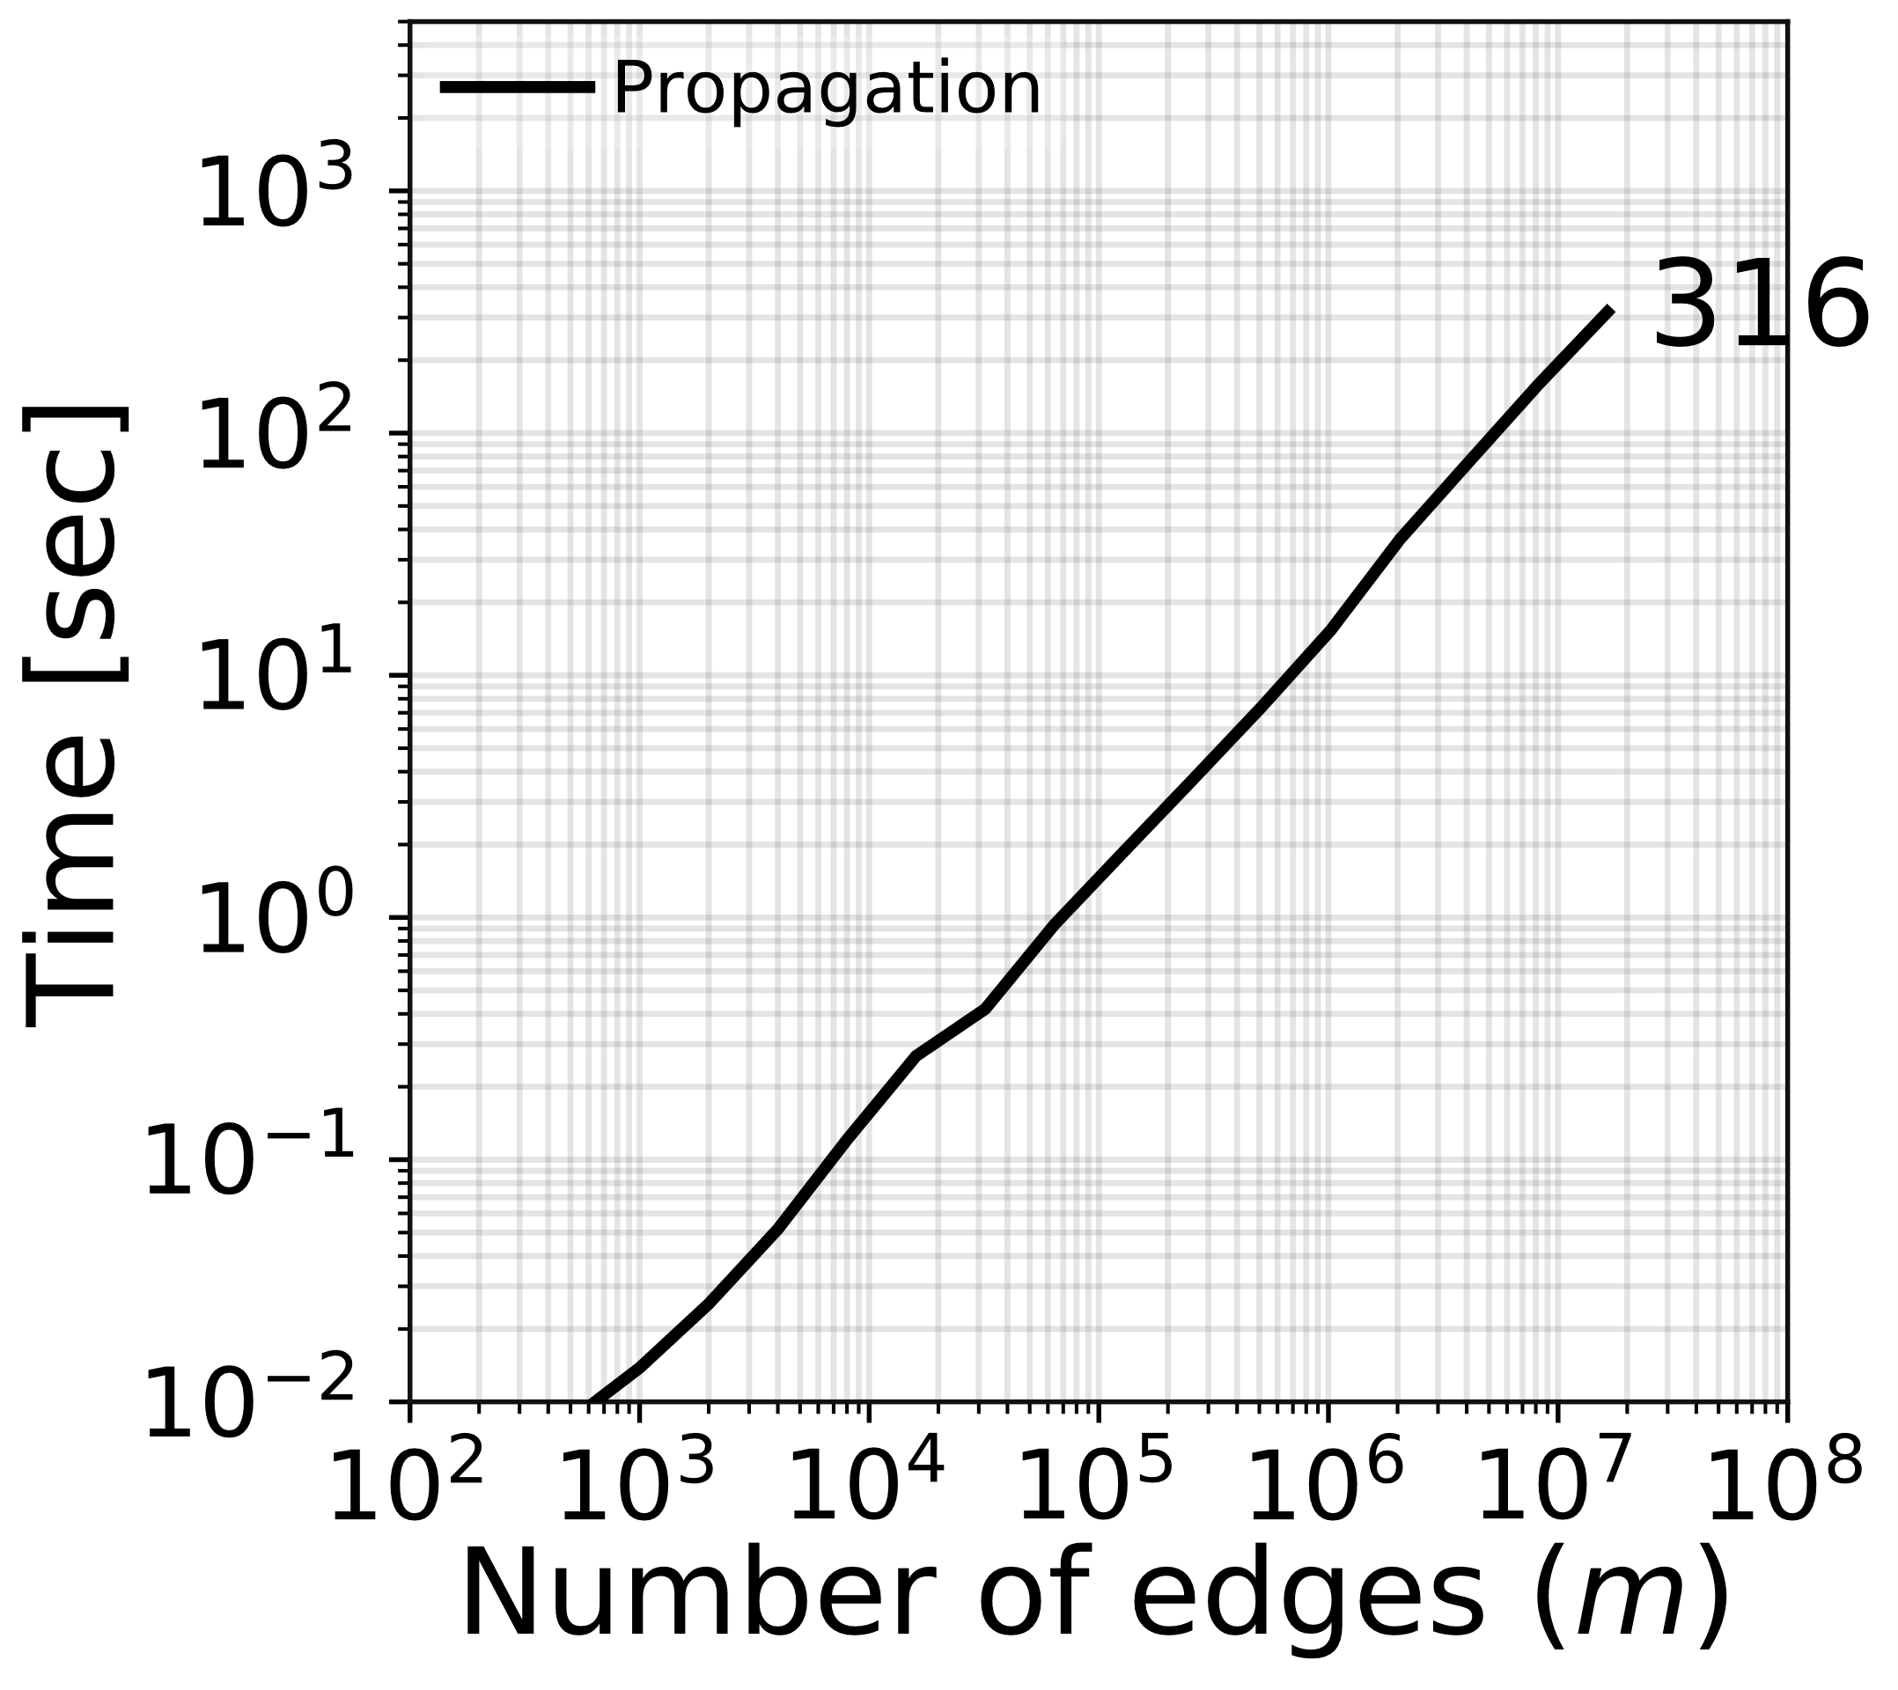
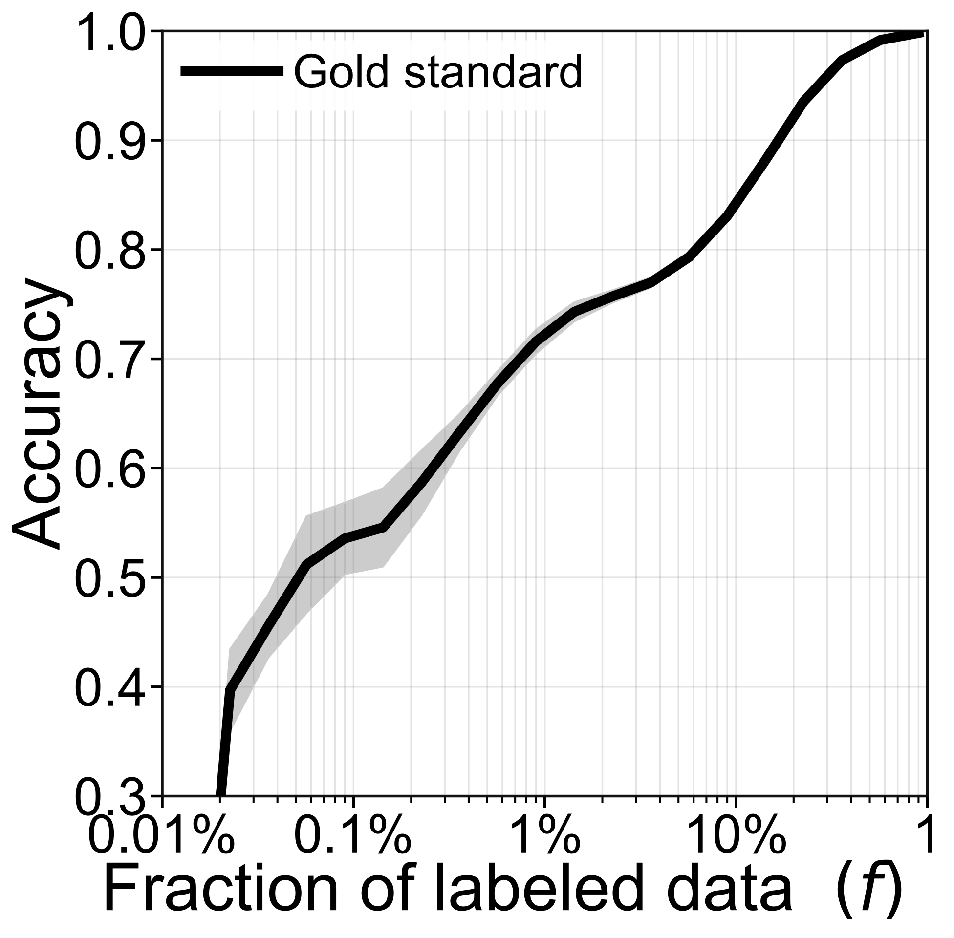
Time and Accuracy for label propagation if we know H
10 labeled nodes
Accuracy by labeling with the true H
Label propagation linear in # edges
Fewer labels
0.2
0.6
0.2
Details: 10k nodes, degree d=25, H =
0.6
0.2
0.2
0.2
0.2
0.6

Slide 7
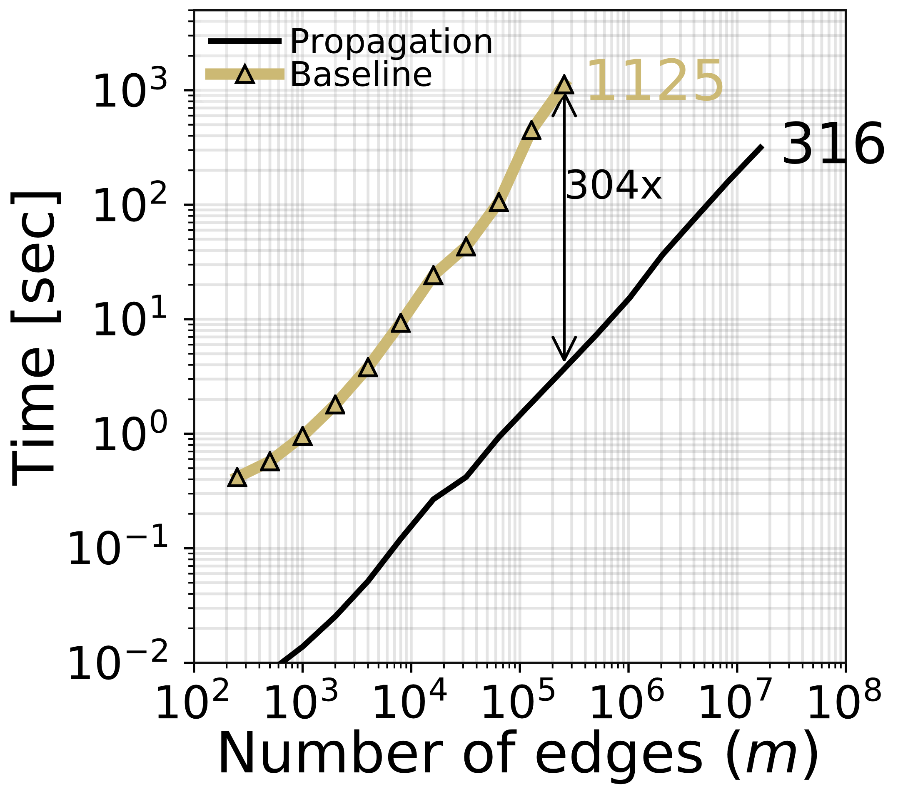
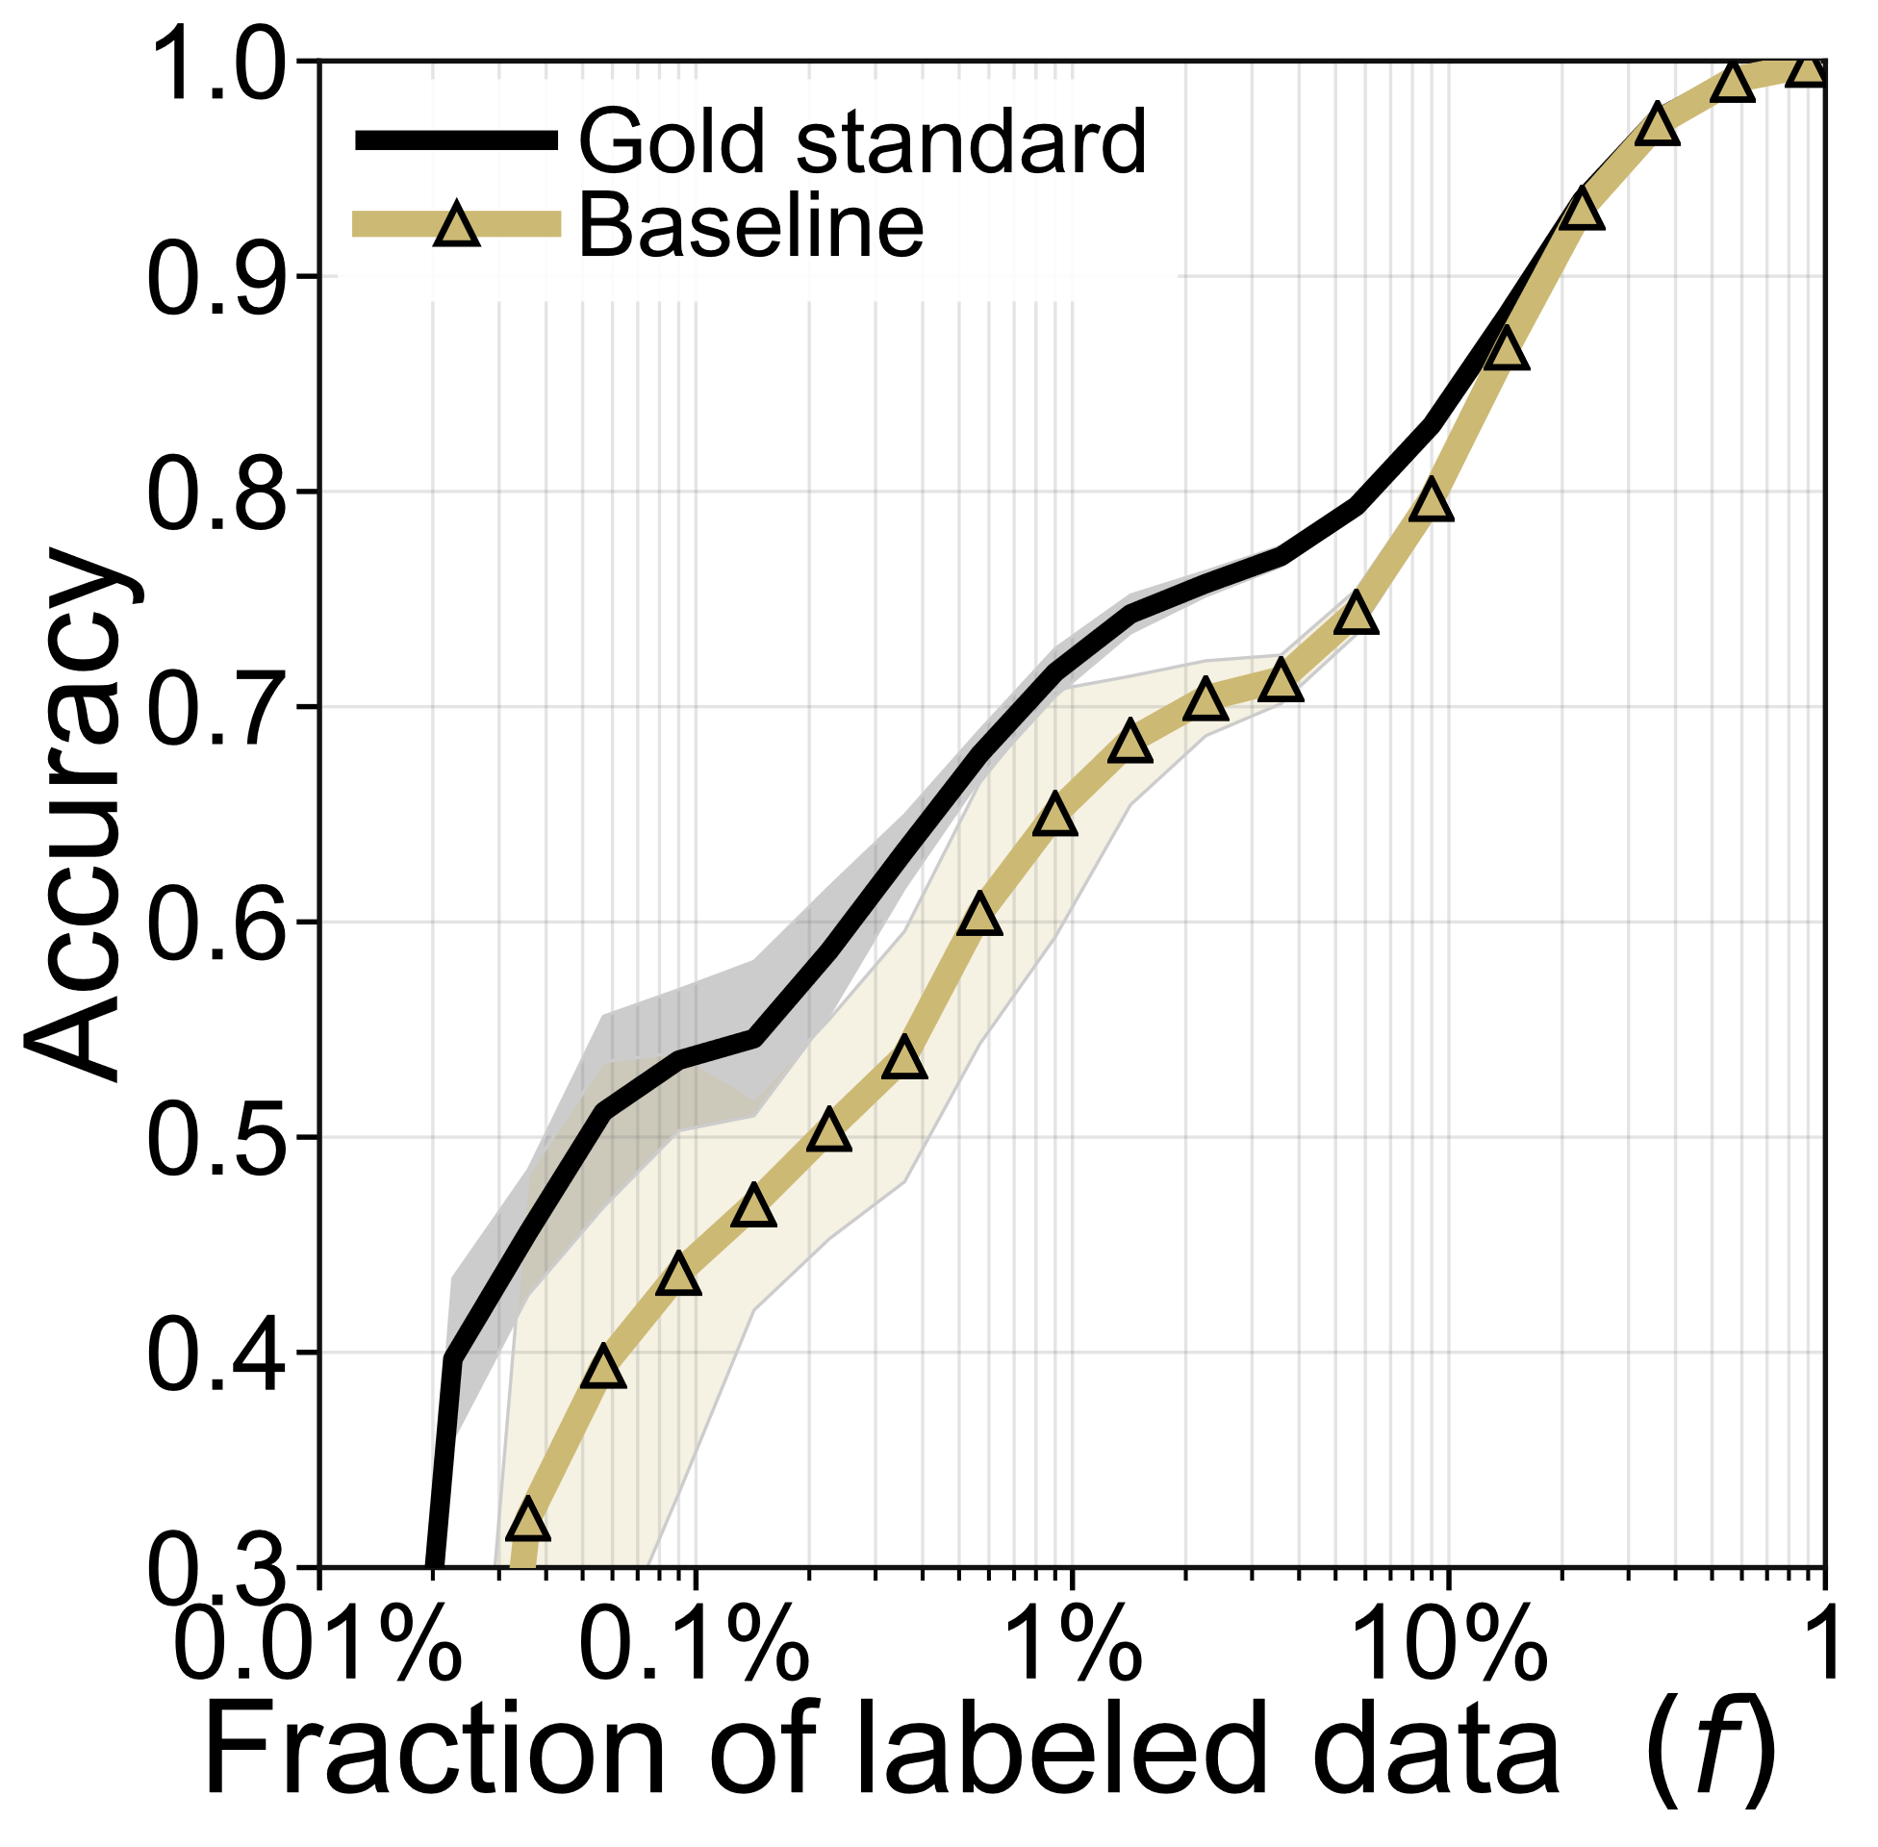
Time and Accuracy if we need to first estimate H ☹
10 labeled nodes
Compatibility estimation based on hold-out sets not that great ☹
Accuracy by labeling with the true H
Estimation uses inference as subroutine (thus slower) ☹
Fewer labels

Slide 8
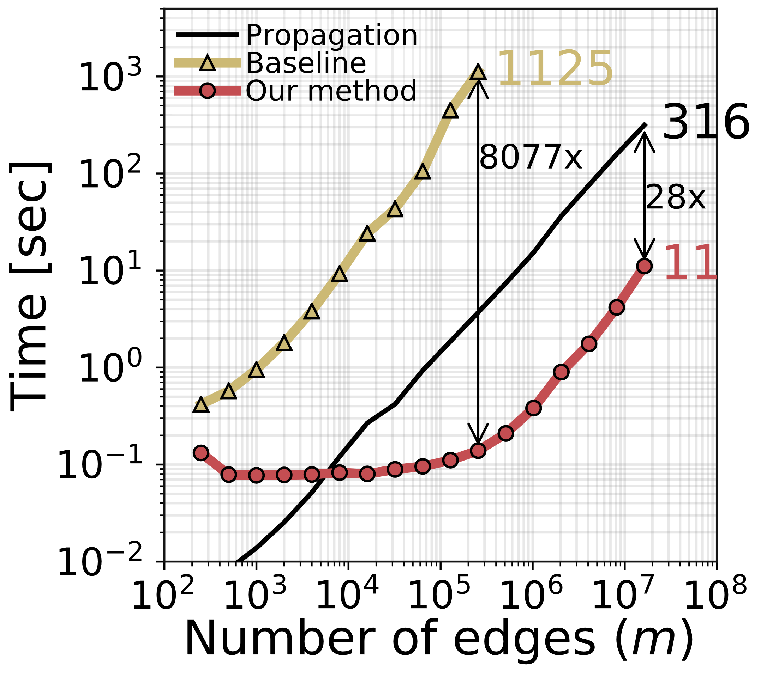
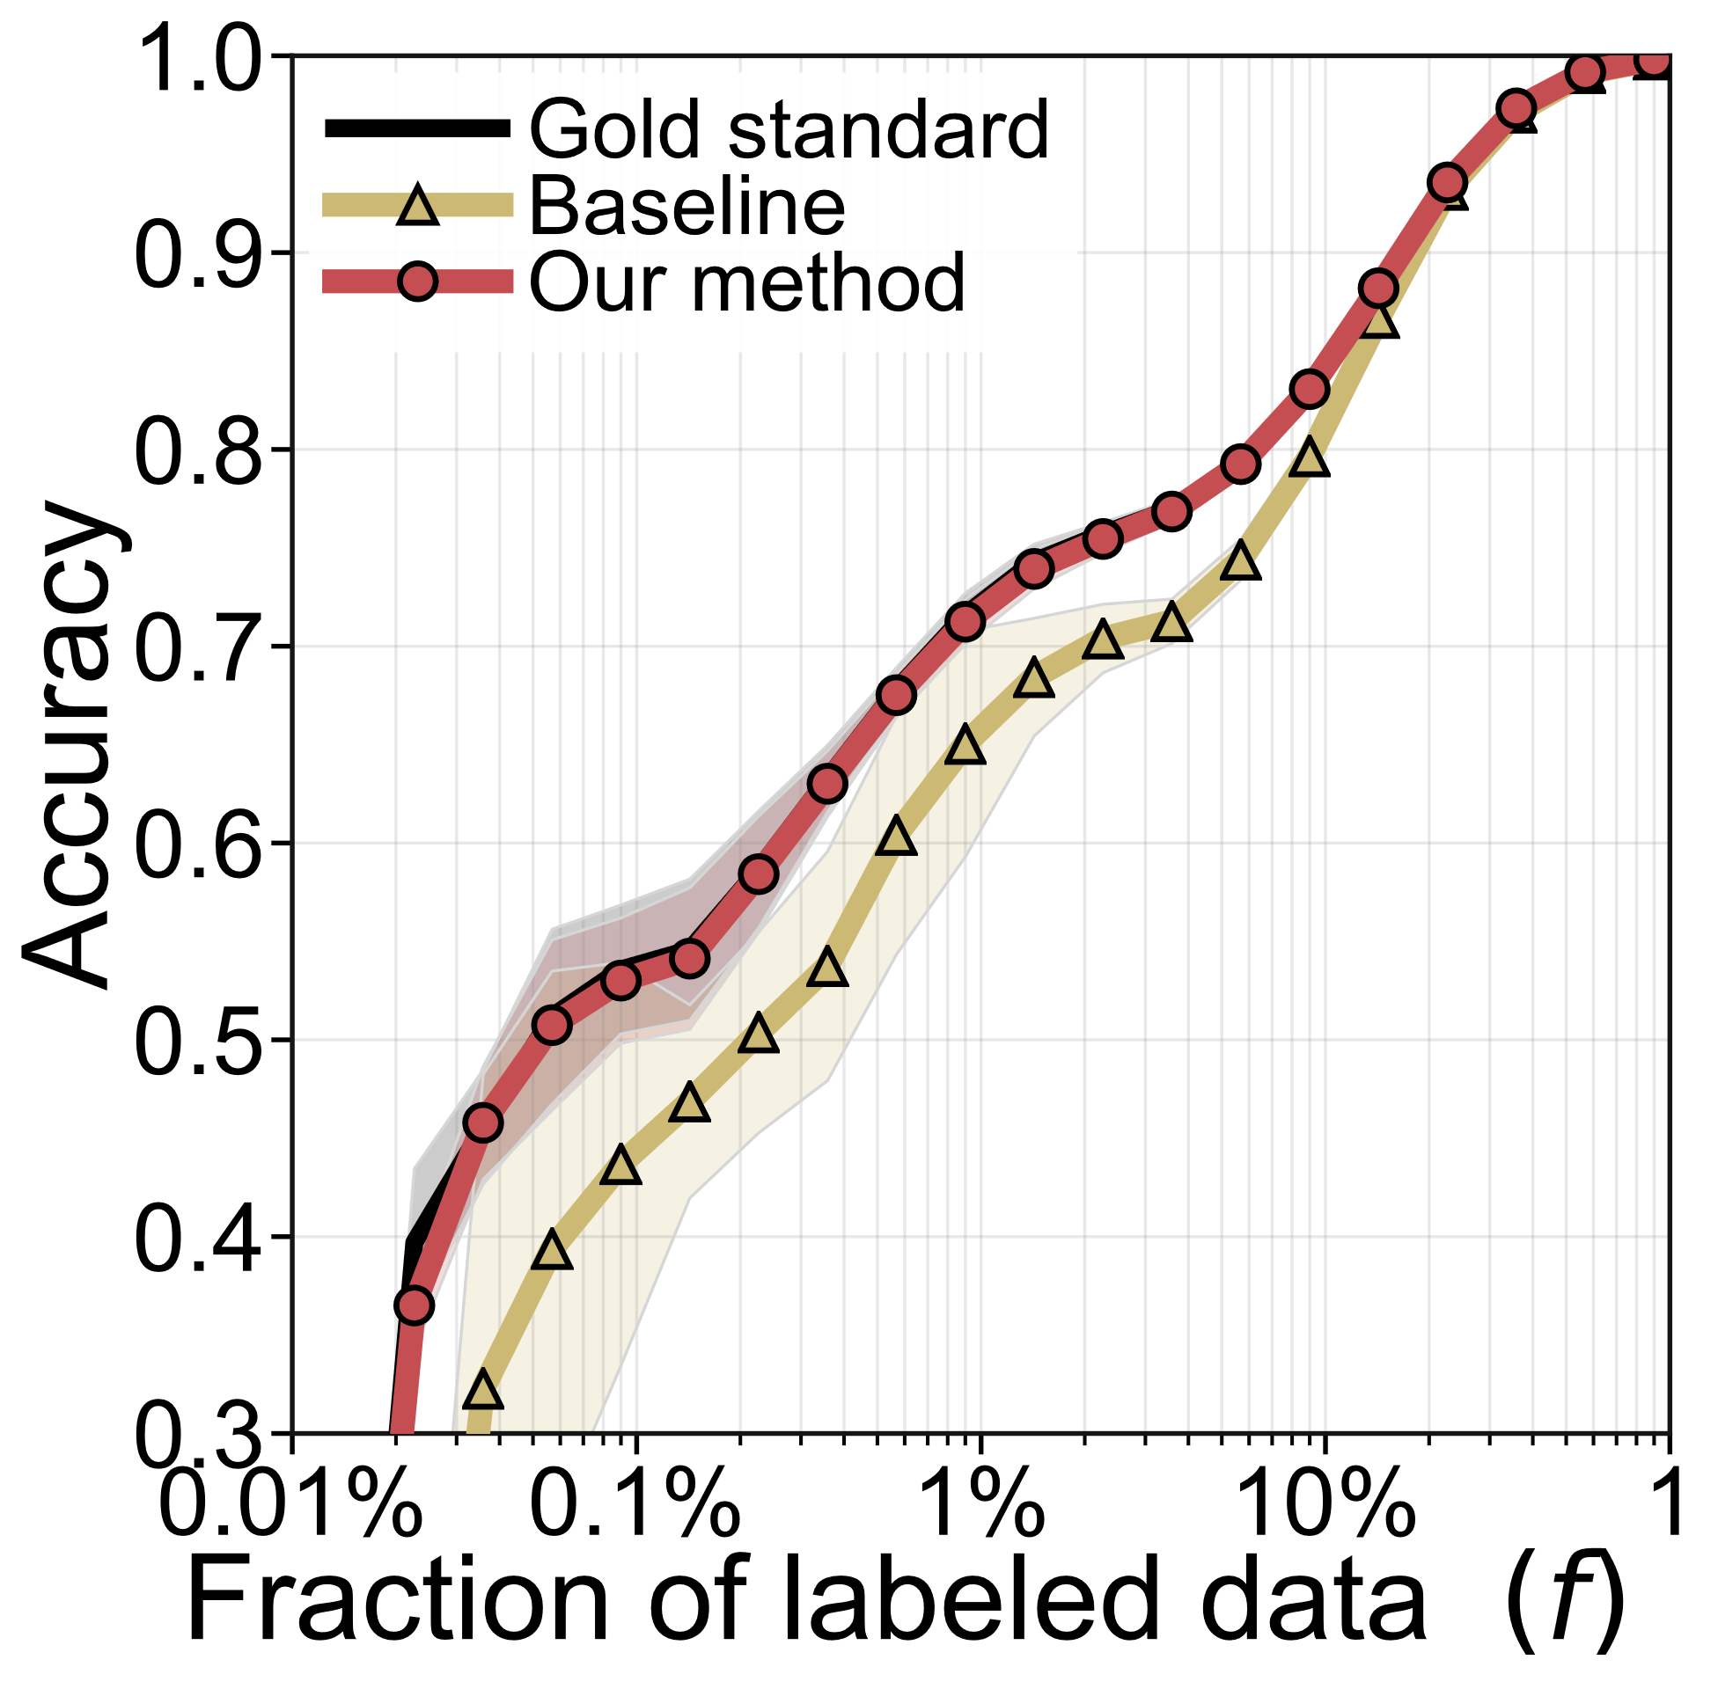
Time and Accuracy with our method ☺
10 labeled nodes
10 labeled nodes
Compatibility estimation based on hold-out sets not that great ☹
Accuracy as good as if estimated on fully labeled graph ☺
Our method for estimating H needs <5% of the time later needed for labeling ☺
Fewer labels
No more need for heuristics or domain experts ☺

Slide 9
What is the trick?

Slide 10
Splitting parameter estimation into two steps
Parameter Estimation
Label Propagation
Derived statistics for path lengths 1,2,…,$ℓ$
Compatibility matrix
?
?
?
1
2
?
?
?
?
?
?
$$O(mkℓ)$$
$k×k$ matrices
$$O(k^{4})$$
$k×k$ matrix
Factorized graph representations
Optimization
Sparsely labeled network
Fully labeled network
independent of graph size
linear in # edges (m)
and # of classes (k)

Slide 11
A myopic view: counting relative neighbor frequencies
Fully labeled graph
Sparsely labeled graph
?
?
?
?
?
?
?
?
?
Neighbor count
Gold standard compatibilities
Labeled neighbor count
2
6
2
0.2
0.6
0.2
0
1
0
Σ=1
$M$=
6
2
2
$$⇒$$
$H$=
0.6
0.2
0.2
$\hat{M}$=
1
0
1
Σ=2
$$⇒$$
$\hat{H}$
2
2
6
0.2
0.2
0.6
0
1
0
Σ=1
Idea: normalize, then find closest symmetric, doubly-stochastic matrix
normalize

Slide 12
A myopic view: counting relative neighbor frequencies
Fully labeled graph
Sparsely labeled graph
?
?
?
?
?
?
?
?
?
Assume f=10% labeled nodes.
What is the percentage of edges with labeled end points
?
Neighbor count
Gold standard compatibilities
2
6
2
0.2
0.6
0.2
$M$=
6
2
2
$$⇒$$
$H$=
0.6
0.2
0.2
2
2
6
0.2
0.2
0.6
1% ☹ Few nodes $⇒$ even fewer edges $mf^{2}$
Σ=1
normalize

Slide 13
Distant compatibility estimation (DCE)
0.2
0.6
0.2
$H$=
0.6
0.2
0.2
0.2
0.2
0.6
0.44
0.28
0.28
$H^{2}$=
0.28
0.44
0.28
0.28
0.28
0.44
$$d=2$$
0.31
0.38
0.31
$H^{3}$=
0.38
0.31
0.31
0.31
0.31
0.38
$$ℓ=1$$
$$ℓ=2$$
$$ℓ=3$$
0
0.6
0.28
0.38
1
0.2
0.44
0.31
0.6, 0.44, 0.38, 0.35, ...
0
0.2
0.28
0.31
Expected signals for neighbors

Slide 14
Distant compatibility estimation (DCE)
0.2
0.6
0.2
graph with:
$m$ edges
$f$ fraction labeled nodes
$d$ node degree
$H$=
0.6
0.2
0.2
0.2
0.2
0.6
Expected # of labeled neighbors of distance $ℓ$
?
$$d=2$$
$d^{ℓ−1}mf^{2}$ expected neighbors of distance $ℓ$
$$ℓ=1$$
$$ℓ=2$$
$$ℓ=3$$
0
0.6
0.28
0.38
1
0.2
0.44
0.31
Idea: amplify the signal from
observed length-$ℓ$ paths ☺
0
0.2
0.28
0.31
Expected signals for neighbors

Slide 15
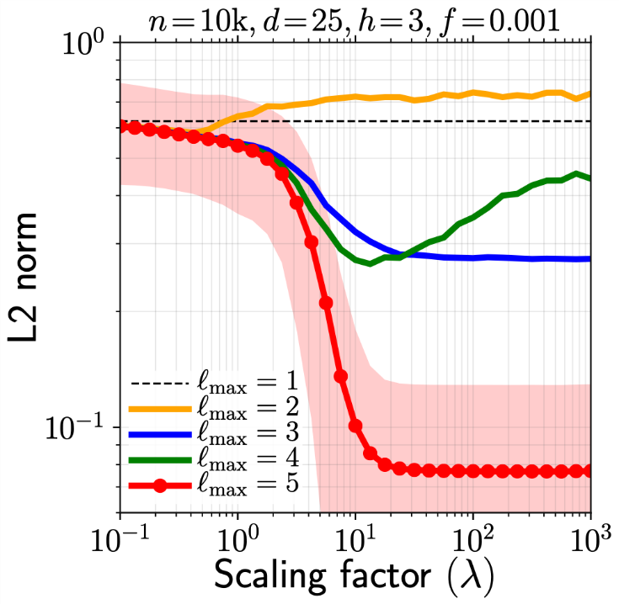
Distant compatibility estimation (DCE)
DETAILS
0.2
0.6
0.2
distance-smoothed energy function
$H$=
0.6
0.2
0.2
$$E\left(H\right)=\sum_{ℓ=1}^{ℓ_{max}}{w_{ℓ}}\left\|{H^{ℓ}−\hat{P}}^{\left(ℓ\right)}\right\|2$$
0.2
0.2
0.6
Statistics for path lengths 1, 2, ...
$$w_{ℓ+1}=λw_{ℓ}$$
$$w={\left[1,λ,λ^{2},…\right]}^{T}$$
$$d=2$$
one single hyperparameter ☺
$$ℓ=1$$
$$ℓ=2$$
$$ℓ=3$$
$$\left\|\hat{H}−H\right\|$$
(smaller is better)
0
0.6
0.28
0.38
1
0.2
0.44
0.31
0
0.2
0.28
0.31
Expected signals for neighbors

Slide 16
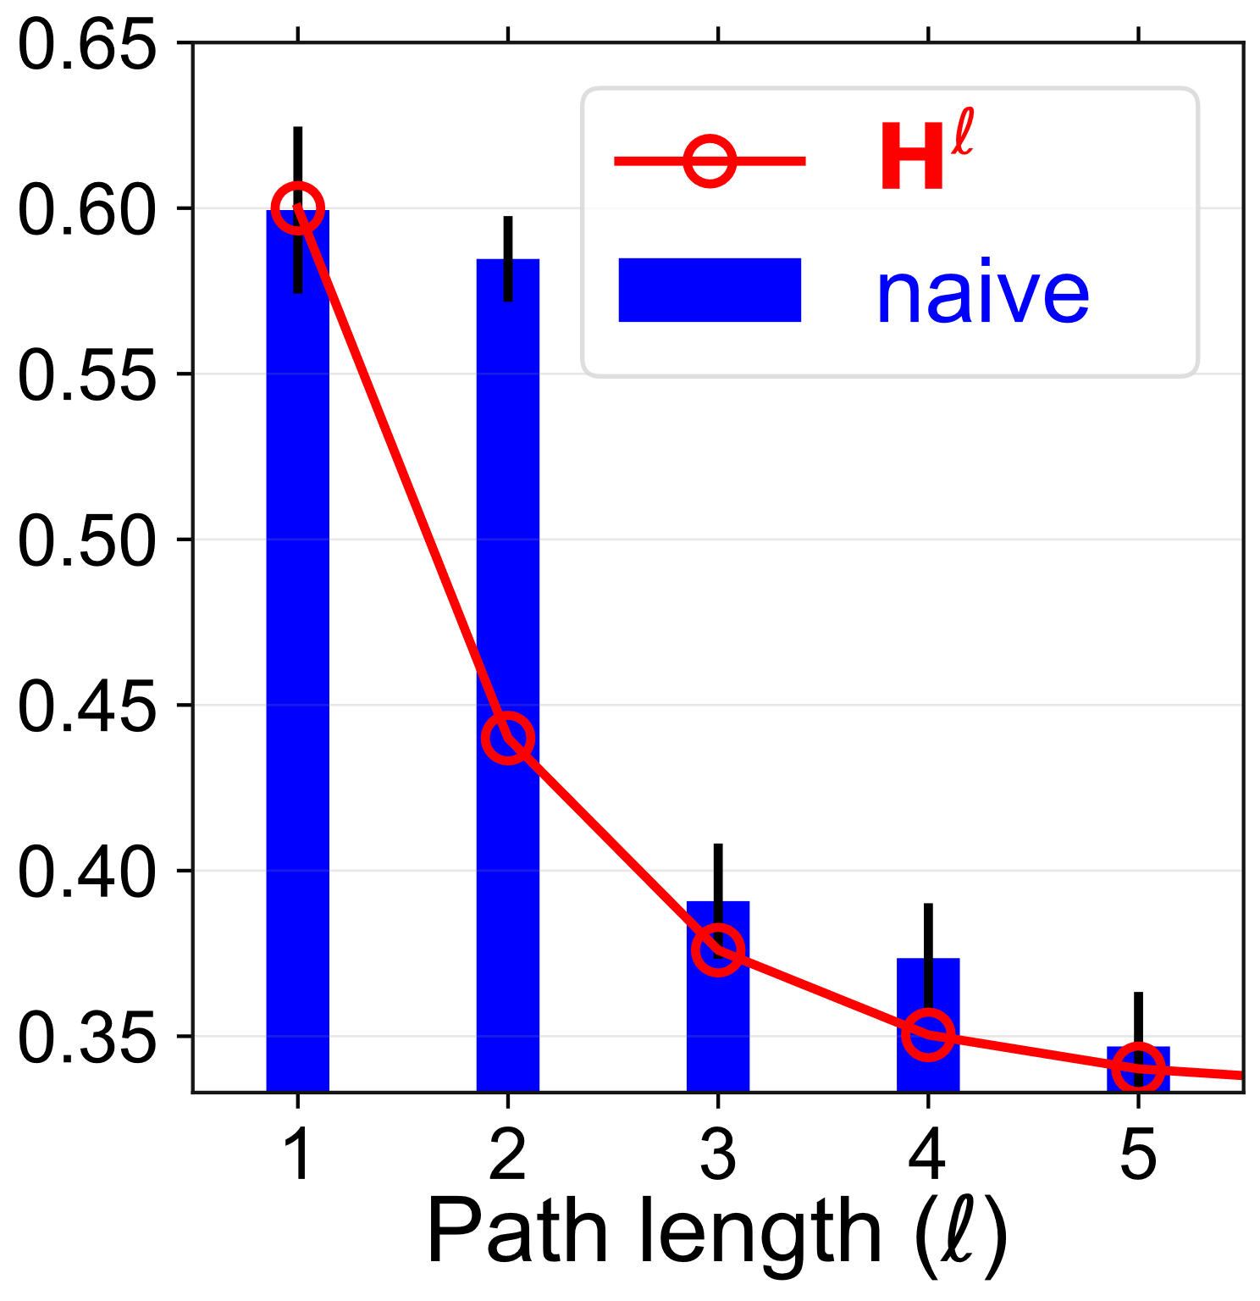
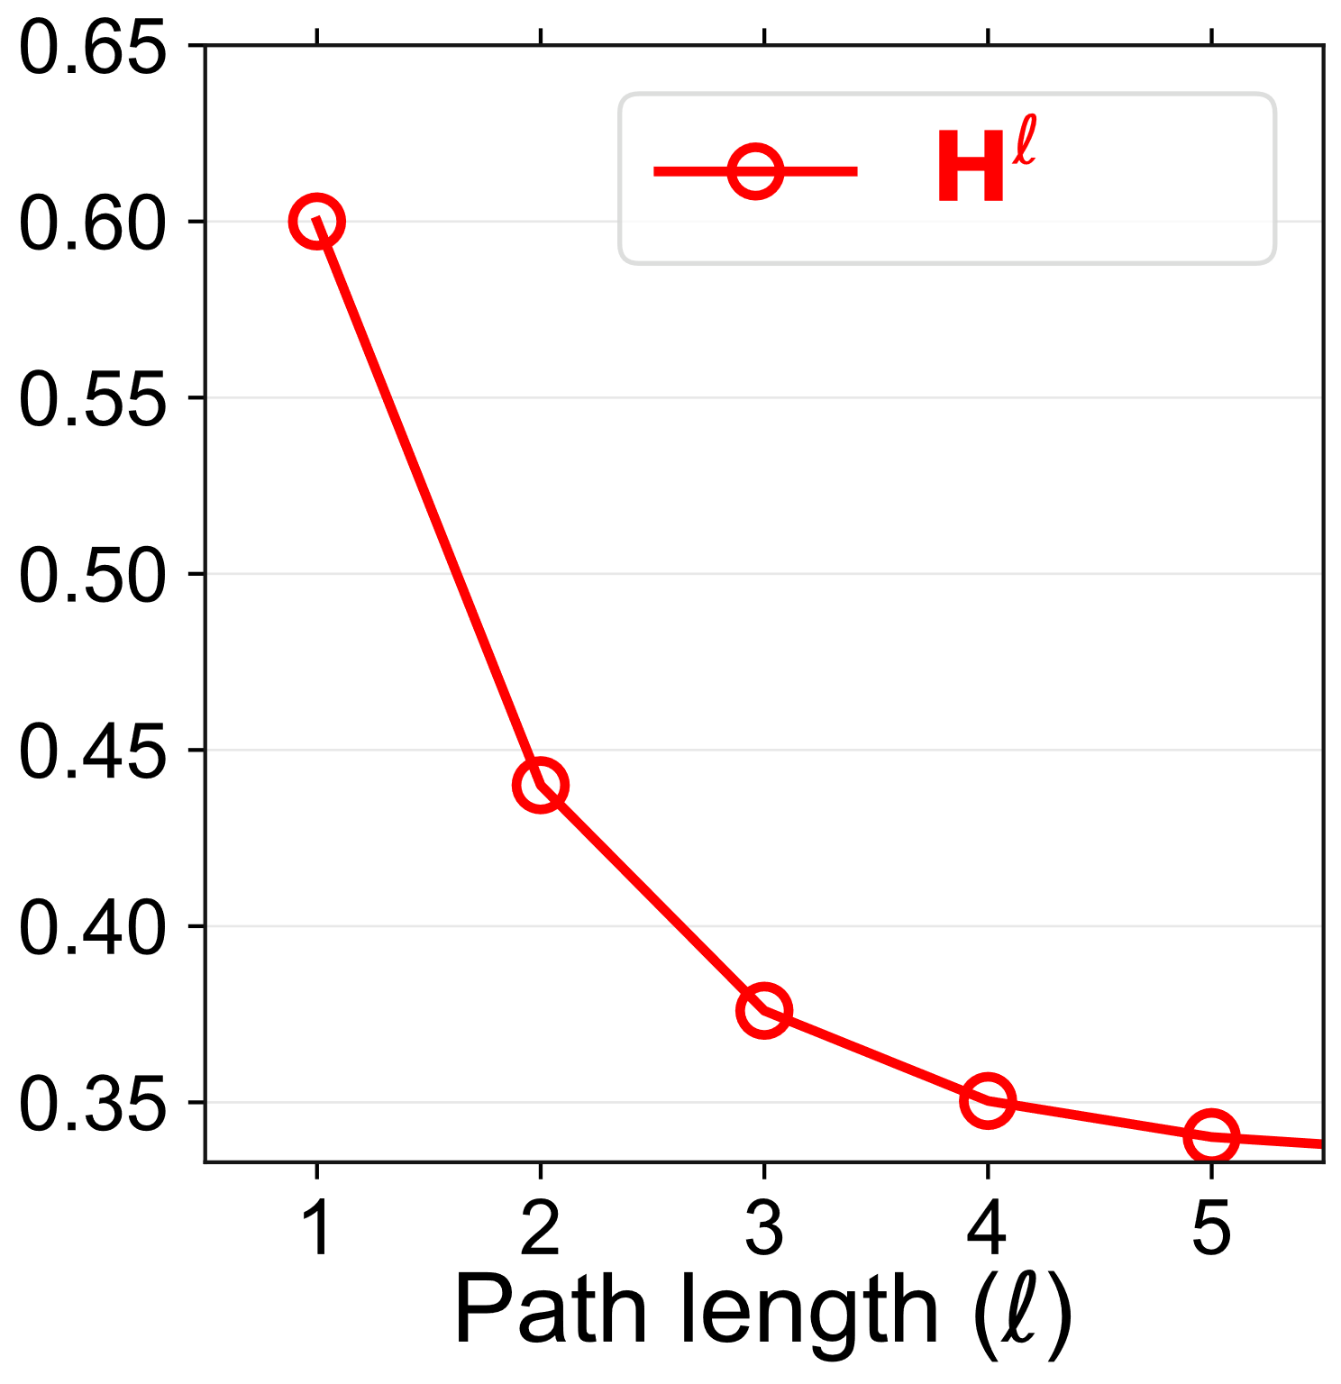
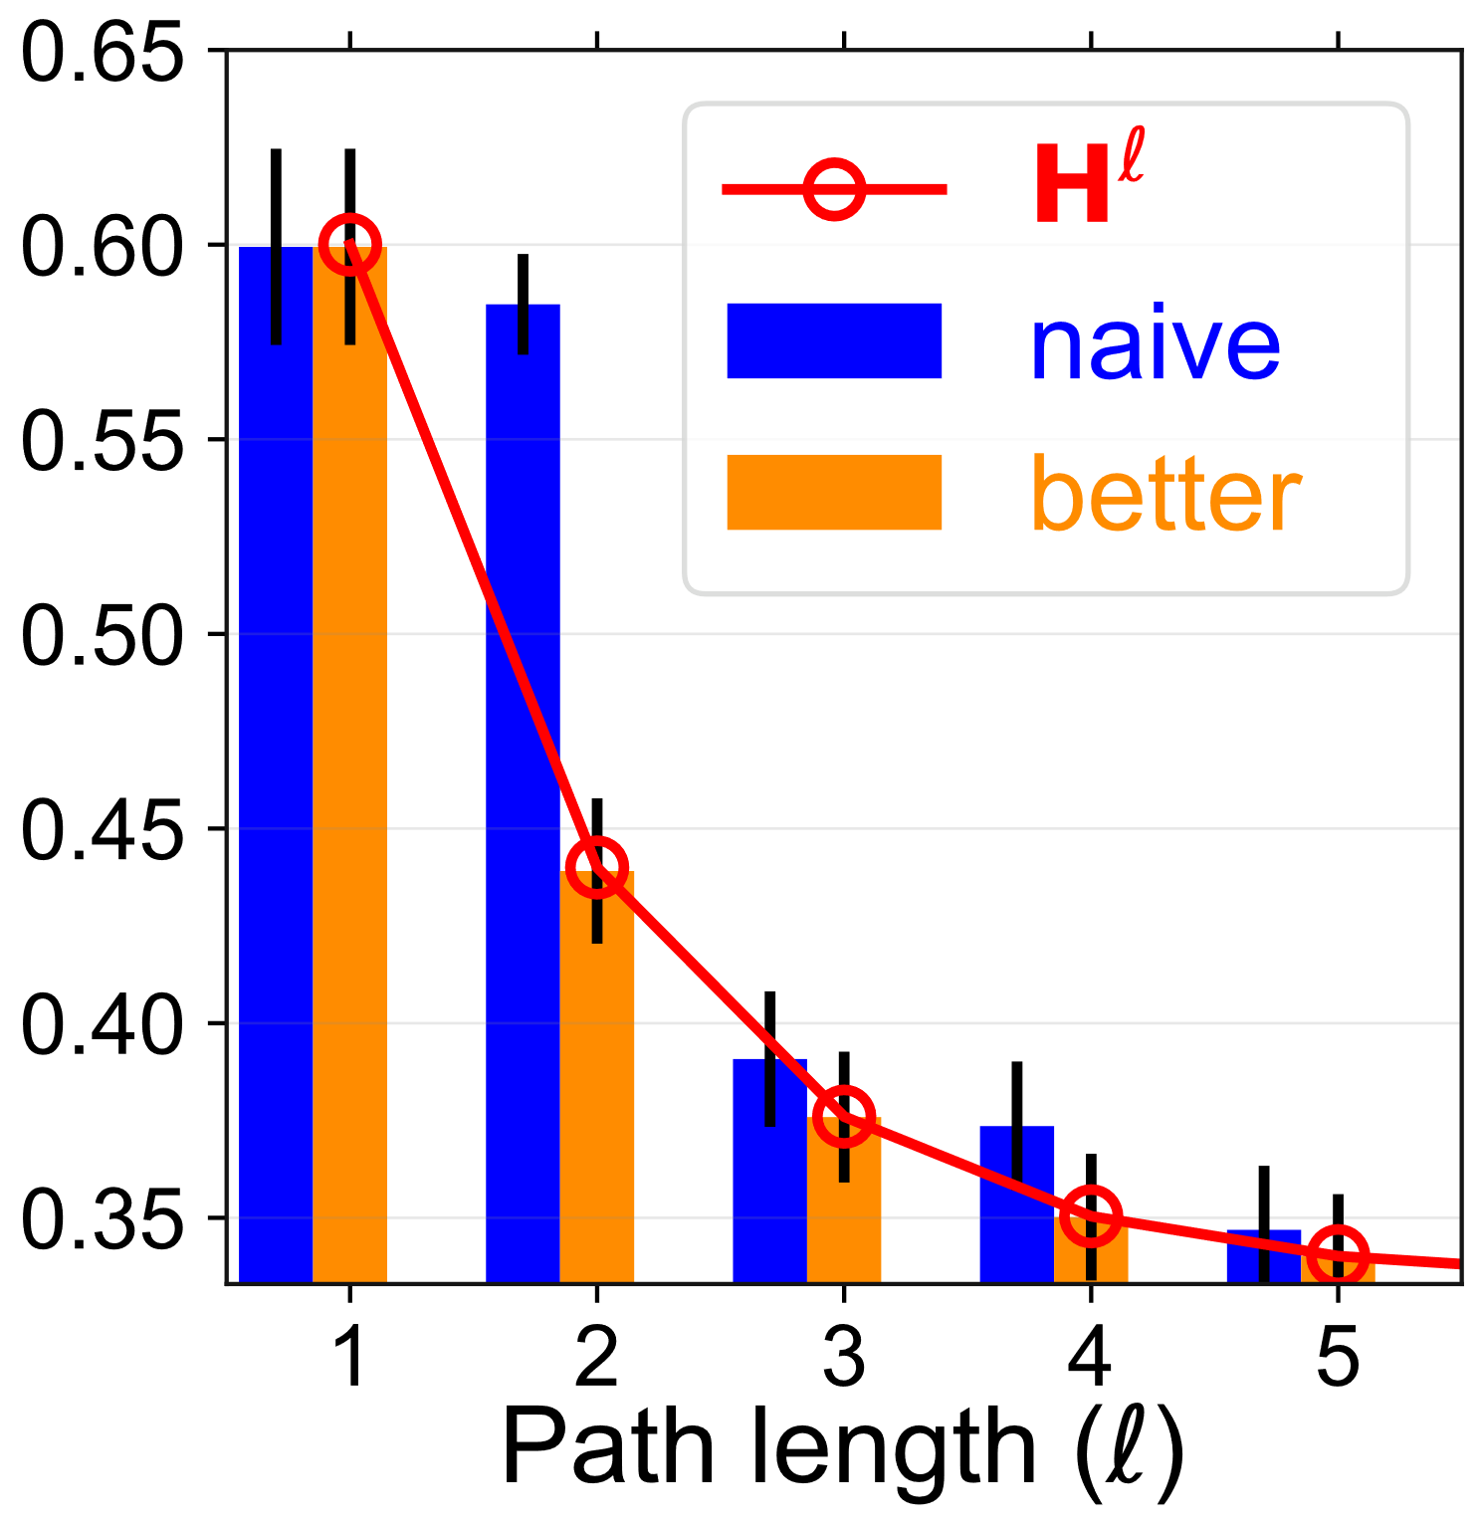
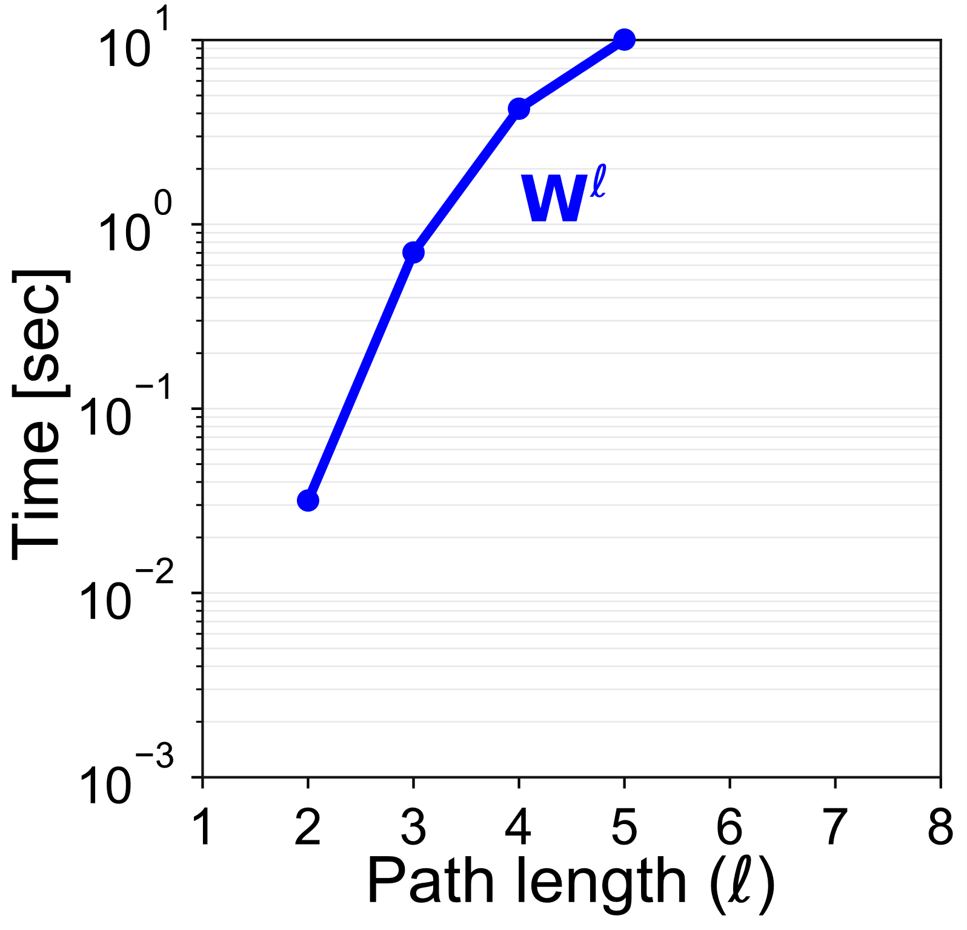
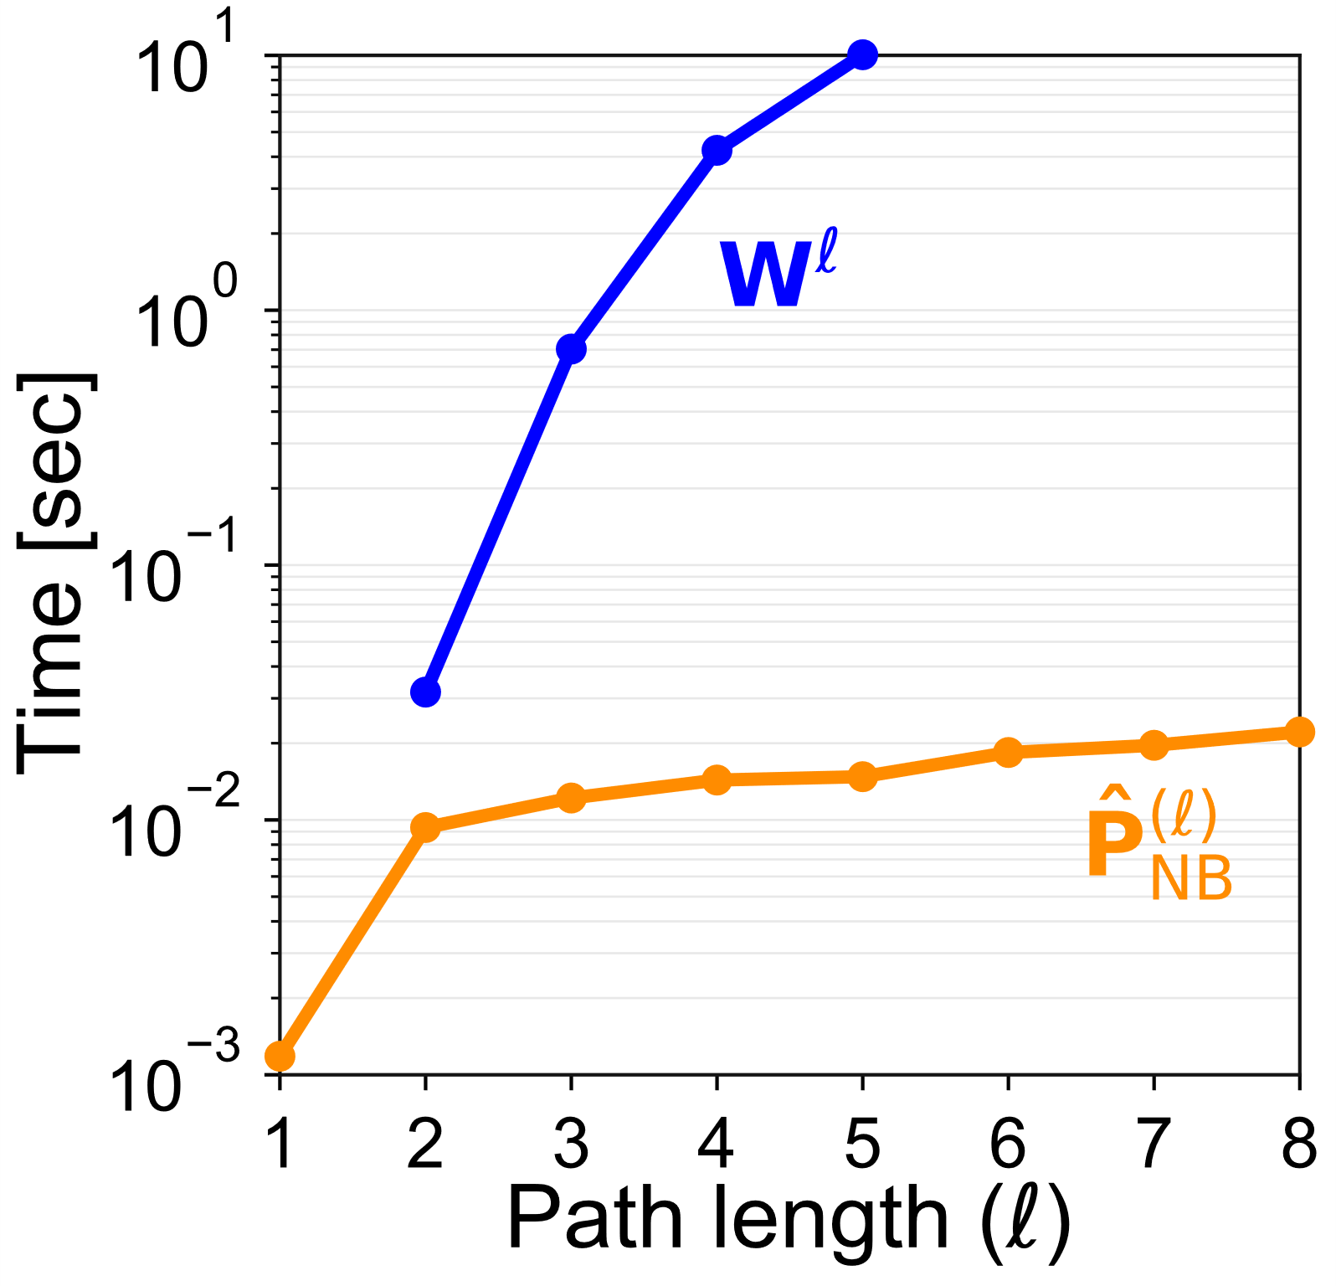
Two technical difficulties
2. Calculating longer paths leads to dense matrix operations ☹
(W = sparse adjacency matrix)
1. Idea from previous page gives biased estimates ☹
$$d=2$$
10 sec too long for 10k nodes ☹
0.6
0.6
Signal
gap ☹
unbiased ☺
10¹⁴ paths in 200 msec
☺ ☺ ☺
0.44
0.44
0.38
0.38
0.35
0.35
?
?
1. We must ignore backtracking paths
2. Requires more careful re- factorization of the calculation
"factorized graph representations"

Slide 17
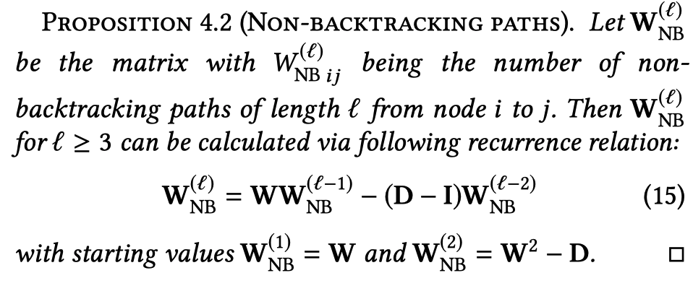
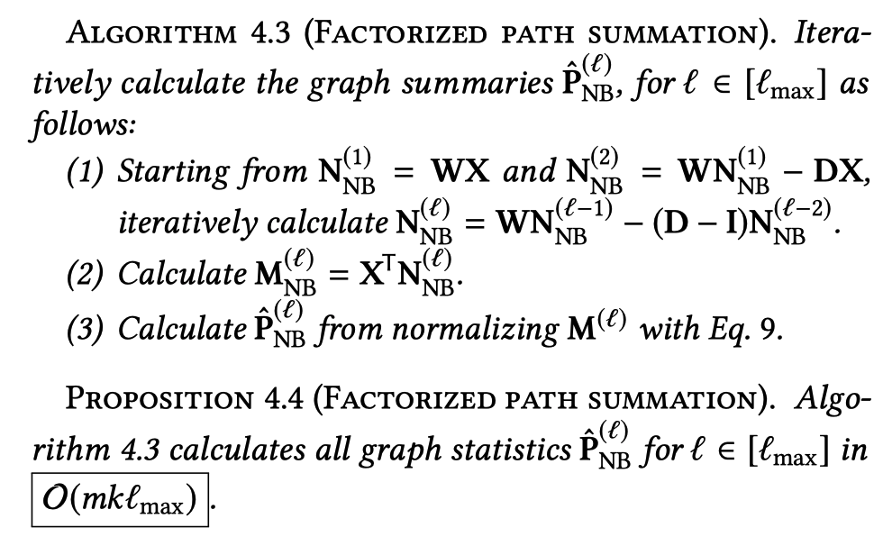
Scalable, Factorized Path summation
Details
Intuition
Relational algebra
$$π_{x}\left(R(x)⋈S(x,y)\right)$$
$$⇒$$
$$R(x)⋈π_{x}S(x,y)$$
(X = thin label matrix)
Linear algebra
$$\left(W⋅W\right)⋅X$$
$$⇒$$
$$W⋅\left(W⋅X\right)$$

Slide 18
Scalable factorized path summation
Intuition
Similar ideas of factorized calculation:
Generalized distributive law [Aji-McEliece IEEE TIT '00]
Algebraic path problems [Mohri JALC'02]
Valuation algebras [Kohlas-Wilson AI'08]
Factorized databases [Olteanu-Schleich Sigmod-Rec'16]
FAQ (Functional Aggregate Queries) [AboKhamis-Ngo-Rudra PODS'16]
Associative arrays [Kepner, Janathan MIT-press'18]
Optimal ranked enumeration [Tziavelis+ VLDB'20]
Relational algebra
$$π_{x}\left(R(x)⋈S(x,y)\right)$$
$$⇒$$
$$R(x)⋈π_{x}S(x,y)$$
(X = thin label matrix)
Linear algebra
$$\left(W⋅W\right)⋅X$$
$$⇒$$
$$W⋅\left(W⋅X\right)$$

Slide 19
More details (super happy to discuss further in 1-on-1's)
Constrained optimization → unconstrained opt. in free parameters
Closed form for gradient: gradient-based optimization even faster
Random restarts for optimization: but for an optimization on graph sketches, thus independent of $n$, yet $Ο\left(k^{4}\right)$
Energy-minimization based explanation of LinBP
Originally proposed "centering" for LinBP not necessary
Proof of unbiased estimator for equal label distribution
Non-backtracking paths in factorized calculation that does not require larger ($2m×2m$) "Hashimoto matrix"
Lots of experiments on real graphs
Even works on graphs without any labeled neighbors ☺

Slide 20
Back to the big picture

Slide 21
"Algebraic cheating" for approximation-aware learning
PGMs
Inference
Learning
Model
Prediction
Approximate
Inference
Labeled data
Algebraic cheating
Prediction'
Loopy BP
Approx.
Model
Inference
Approximation- aware Learning
Prediction''
LinBP
DCE
H
For more details please visit
[Arxiv 2014] Semi-supervised learning with heterophily
[VLDB 2015] Linearized and Single-pass belief propagation
[AAAI 2017] The linearization of pairwise Markov random fields [VLDBJ 2017] Dissociation and propagation for approximate lifted inference [UAI 2018] Dissociation-based oblivious bounds for weighted model counting [SIGMOD 2019] Anytime approximation in probabilistic databases via scaled dissociations [SIGMOD 2020] Factorized graph representations for semi-supervised learning from sparse data Supported by NSF IIS-1762268-CAREER: Scaling approximate inference and approximation-aware learning
https://db.khoury.northeastern.edu/
Thank you ☺

