Slide 1



Recorded version: Sept 21, 2011
Databases will visualize
queries too
Wolfgang Gatterbauer
Aug 30, 2011 (VLDB'11)
University of Washington
Database Group
http://queryviz.com

Slide 2
Interactions between Users and Queries are hard
Intent: Find...
essential for Query Browse and Re-use
hard
SQL
Query Interpretation
SELECT A
FROM R
WHERE B not in
(SELECT D
FROM S)
Query Composition
Recent work on Query Management:
Idea: Re-use and adapt existing queries
Problem:
Query Interpretation is hard too!
CQMS
Khoussainova+ [CIDR’09]
even used for testing purposes,
e.g., on www.gradiance.com
SQL QuerIE
Chatzopoulou+ [SSDBM’09]
SQLshare
Howe+ [MS eSc WS’10]
DBease
Li+ [CIDR’11]

Slide 3
Browsing & Understanding existing Queries is hard
hard
1
2
3
4
select W1.wid
from Worlds W1
where not exists
(select *
from Worlds W2
where W2.wid < W1.wid
and not exists
(select *
from Worlds W3
where W3.wid = W1.wid
and not exists
(select *
from Worlds W4
where W4.wid = W2.wid
and W4.tid = W3.tid)))
5
select S.sname
from Sailors S
where not exists
(select B.bid
from Boats B
where not exists
(select R.bid
from Reserves R
where R.bid = B.bid
and R.sid = S.sid))
select distinct a3.fname, a3.lname
from Actor a0, Casts c0, Casts c1, Casts c2, Casts c3,
Actor a3
where a0.fname = 'Kevin' and a0.lname = 'Bacon'
and c0.pid = a0.id and c0.mid = c1.mid
and c1.pid = c2.pid and c2.mid = c3.mid
and c3.pid = a3.id
and not exists (select xc1.pid
from Actor xa0, Casts xc0, Casts xc1
where xa0.fname = 'Kevin' and xa0.lname = 'Bacon'
and xa0.id = xc0.pid and xc0.mid = xc1.mid
and xc1.pid = a3.id)
and not exists (select ya0.id
from Actor ya0
where ya0.fname = 'Kevin' and ya0.lname = 'Bacon’)
select F1.person
from Frequents F1
where not exists
(select F2.bar
from Frequents F2
where F2.person = F1.person
and not exists
(select S3.drink
from Serves S3, Likes L4
where L4.person = F1.person
and L4.drink = S3.drink
and S3.bar = F2.bar))
select Team, Day
from Scores S1
where not exists
(select *
from Scores S2
where S1.Runs = S2.Runs
and (S1.Team <> S2.Team
or S1.Day <> S2.Day))

Slide 4
Can Query Visualization help?
easy
hard
1
1
2
2
3
3
4
4
select W1.wid
from Worlds W1
where not exists
(select *
from Worlds W2
where W2.wid < W1.wid
and not exists
(select *
from Worlds W3
where W3.wid = W1.wid
and not exists
(select *
from Worlds W4
where W4.wid = W2.wid
and W4.tid = W3.tid)))
5
5
select S.sname
from Sailors S
where not exists
(select B.bid
from Boats B
where not exists
(select R.bid
from Reserves R
where R.bid = B.bid
and R.sid = S.sid))
select distinct a3.fname, a3.lname
from Actor a0, Casts c0, Casts c1, Casts c2, Casts c3,
Actor a3
where a0.fname = 'Kevin' and a0.lname = 'Bacon'
and c0.pid = a0.id and c0.mid = c1.mid
and c1.pid = c2.pid and c2.mid = c3.mid
and c3.pid = a3.id
and not exists (select xc1.pid
from Actor xa0, Casts xc0, Casts xc1
where xa0.fname = 'Kevin' and xa0.lname = 'Bacon'
and xa0.id = xc0.pid and xc0.mid = xc1.mid
and xc1.pid = a3.id)
and not exists (select ya0.id
from Actor ya0
where ya0.fname = 'Kevin' and ya0.lname = 'Bacon’)
select F1.person
from Frequents F1
where not exists
(select F2.bar
from Frequents F2
where F2.person = F1.person
and not exists
(select S3.drink
from Serves S3, Likes L4
where L4.person = F1.person
and L4.drink = S3.drink
and S3.bar = F2.bar))
select Team, Day
from Scores S1
where not exists
(select *
from Scores S2
where S1.Runs = S2.Runs
and (S1.Team <> S2.Team
or S1.Day <> S2.Day))
Casts
Casts
Casts
Casts
Actor
pid
pid
pid
pid
id
mid
mid
mid
mid
fname='Kevin'
select
select
Frequents
Scores
W
Scores
lname='Bacon'
Frequents
Serves
wid
select
Sailors
Reserves
Boats
person
person
Actor
bar
Actor
Casts
Casts
person
select
Team
W
Team
Team
W
SELECT
id
pid
>
id
pid
bar
drink
name
name
bid
bid
wid
wid
fname='Kevin'
wid
fname
fname
Day
mid
mid
lname
lname
Day
lname='Bacon'
Day
sid
sid
tid
Runs
Likes
W
Runs
person
Actor
wid
drink
id
tid
fname='Kevin'
lname='Bacon'
Query Intent: "Find all actors with Bacon number 2."

Slide 5
Four principal ways for Query Interpretation
with SQL
e.g., syntactic highlighting
e.g., aligning query blocks
1
Manipulate SQL text
How to facilitate
SQL query
interpretation?
represent other
than query
2
Show query results
e.g., example data results,
related to
Olston+ [Sigmod’09]
as combination of input / output / query?
w/o SQL
in NL
Ioannidis+
[NLDB’08, CIDR'09, ICDE'10]
3
Translate into NL text
represent
query
as
visual
4
Visualize Query
http://queryviz.com
as a different query language ?
as music ?
as ???

Slide 6
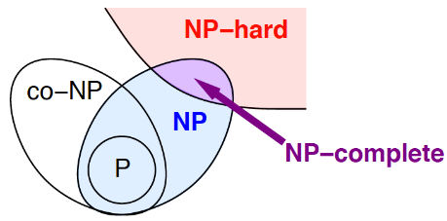
"A picture is worth 1000 words"
Text
Visual
"... P is the set of problems that can be solved quickly... NP is the set of decision problems where we can verify a YES answer quickly if we have the solution in front of us... A problem is NP-hard if a polynomial-time algorithm for would imply a polynomial-time algorithm for every problem in NP... If the answer to a problem in co-NP is NO, then there is a proof of this fact that can be checked in polynomial time...a problem is NP-complete if it is both NP-hard and an element of NP."
"...what we think the world looks like" according to
Erickson [lecture notes’09]

Slide 7
Query Visualization vs. Visual Query Languages
easy
hard
Target to Visualize
Data
Queries
User Action
Interpret
(Read)
Information
Visualization
Query
Visualization
Compose
(Write)
Visual Query
Languages
_______________
Lot of recent focus in DB
(and far more before in HCI)
Lot of past work in DB, see e.g. survey
Catarci+ [J. Vis. Lang. Comput.’97]

Slide 8
Visual Interpretation vs. Visual Composition
easy
hard
Communication Medium
Text
Visual (graphics)
User Action
Interpret
(Read)
Sequential
Parallel
Compose
(Write)
Sequential
Sequential
Suggestion (why VQL have not found wide adoption): Visual composition is an inherently sequential process. In contrast, Query Visualization is different and can
use the full bandwith of human visual perception.

Slide 9
The Challenge
Find the appropriate visual alphabet which
(i) allows users to quickly understand a query's intent,
(ii) can be easily learned by users, and
(iii) can express a large fraction of SQL.
goals
Additionally, find
(iv) automatic translations from SQL to the visualization.

Slide 10
Agenda
  Why Query Visualization?
  The Development of QueryViz
(joint work with Jonathan Danaparamita)

Slide 11
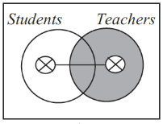
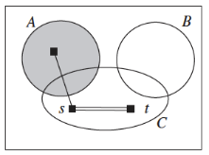
Inspiration from Diagramatic Reasoning
Diagramatic reasoning systems
Howse [ICCS’08]
"There is an element that is a student or a teacher but not both, and the set of Teachers is empty."
"s represents an individual in the set C – A  B iff s re-presents the same individual as t."
Inspired by Euler graphs, Venn diagrams, existential graphs by C. Sanders Pierce
Idea: use topological properties, such as enclosure, to re-present logical expressions and set-theoretic relationships
First-Order Logic (FOL) representation of SQL
select a
from R
where b not IN
(select d
from S)
SQL
FOL
a: ∃b.∃c.[R(a,b,c) ∧ ¬(∃d.∃e.[S(d,e) ∧ b=d])]
Design decision 1: start from FOL representation of SQL queries and represent it with topological properties

Slide 12
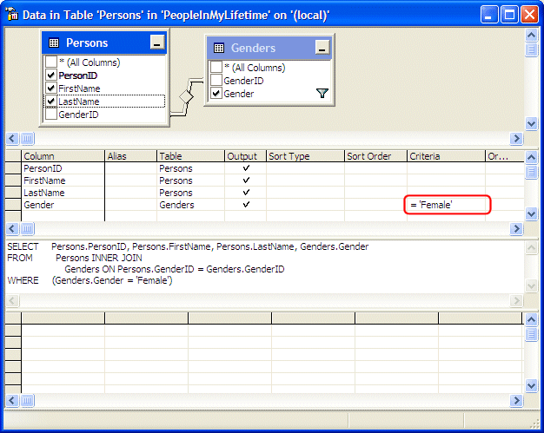
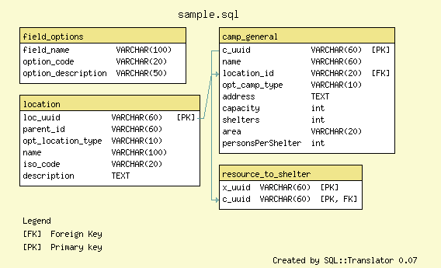
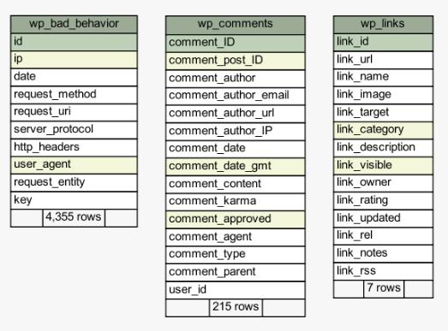
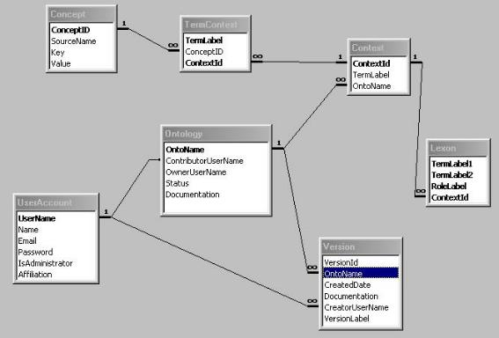
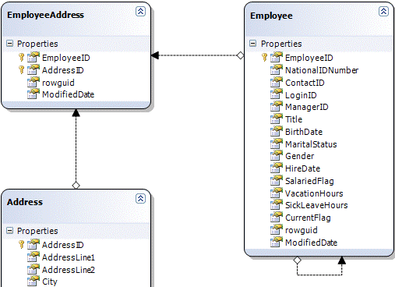
DB schemas as familiar visual construct
Design decision 2: start from known visual UML metaphors for DB schemas

Slide 13
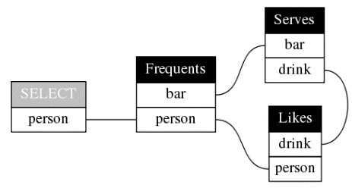
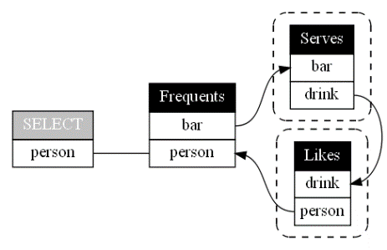
Incremental Complexity
Design decision 3: gradually extend known visual metaphors for CQs
Likes(person, drink)
Frequents(person, bar)
Serves(bar, drink, price)
Unlike SQL: no aliases needed; schema implicit
select F.person
from Frequents F, Likes L, Serves S
where F.person = L.person
and F.bar = S.bar
and L.drink = S.drink
Unlike Datalog: no anony-mous variables shown
Q(x) :- Frequents(x,y), Serves (y,z,_), Likes (x,z)
Q: Find persons that frequent some bar that serves some drink they like.
+167% more SQL text
+13% more visual elements
¬∃: dashed line
around relation
select F.person
from Frequents F
where not exists
(select S.drink
from Serves S
where S.bar = F.bar
and not exists
(select L.drink
from Likes L
where L.person = F.person
and S.drink = L.drink))
Design decision 4: assign an implicit reading order to the arrow
Q: Find persons that frequent some bar that serves only drinks they like.

Slide 14
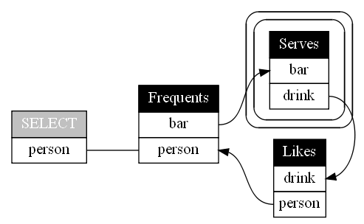
Logical transformations
∀: double line
around relation
Likes(person, drink)
Frequents(person, bar)
Serves(bar, drink, price)
Design decision 5: limited logical transfor-mation can further simplify representation
Q: Find persons that frequent a bar so that they like all drinks served.
Q: Find persons that frequent some bar so that there is no drink served
that the person does not like.
p₁: ∃b₁.[F(p₁,b₁)∧∀b₂.∀d₂.[S(b₂,d₂)∧b₂=b₁⇒∃p₃.∃d₃.[L(p₃,d₃)∧p₃=p₁∧d₃=d₂]}]
p₁: ∃b₁.[F(p₁,b₁)∧¬(∃b₂.∃d₂.[S(b₂,d₂)∧b₂=b₁∧¬(∃p₃.∃d₃.[ L(p₃,d₃)∧p₃=p₁∧d₃=d₂])])]
¬∃: dashed line
around relation
select F.person
from Frequents F
where not exists
(select S.drink
from Serves S
where S.bar = F.bar
and not exists
(select L.drink
from Likes L
where L.person = F.person
and S.drink = L.drink))
Q: Find persons that frequent some bar that serves only drinks they like.

Slide 15
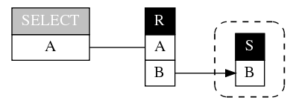
QueryViz for Query Intent, not Debugging
Discontinuity with NULL values
select R.A
from R
where not exists
(select *
from S
where S.B = R.B)
select R.A
from R
where R.B not IN
(select S.B
from S)
Empty result if S.B contains NULL
Discontinuity with empty tables
select R.a
from R, S
where R.a=S.a
or exists
(select *
from T
where R.a=T.a)
select R.a
from R, S, T
where R.a=S.a
or R.a=T.a
S
SELECT
R
A
A
A
T
A
Empty result if T is empty
Design decision 6: minimum visual complexity  possible overloading and ambiguity just as in NL

Slide 16
http://queryviz.com
Input: Schema
Input Query
Output: Visualization
Danaparamita+ [EDBT'11]

Slide 17
Wide Open Questions
1. How to visualize outer joins, sorting, arithmetic expressions, etc.?
2. What is the appropriate level of abstraction? (intent vs. debugging)
3. What are the appropriate basic visual metaphors?
4. Can we visualize at different granularities? ("zooming in")
5. How can we visualize query fragments?
6. How to adapt visualizations to audiences? ("one size fit all")
7. How to optimally place the visual elements?
8. How to standardize evaluation of alternative approaches?
("TPC-H for speed of Query Interpretation" via user studies)

Slide 18
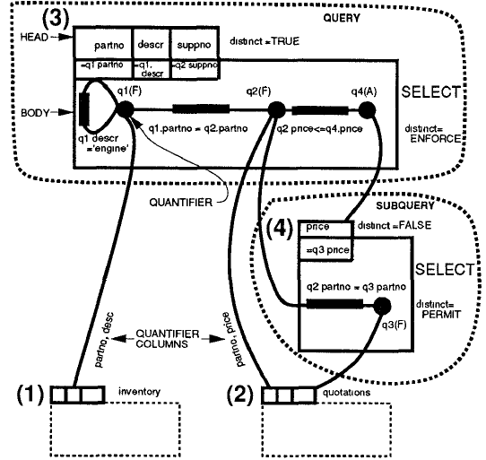
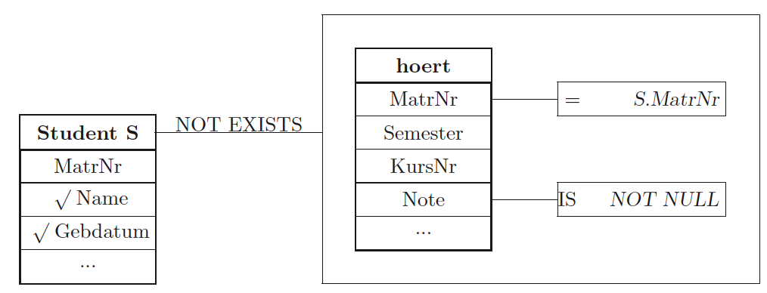
Wide Open Questions
1. How to visualize outer joins, sorting, arithmetic expressions, etc.?
2. What is the appropriate level of abstraction? (intent vs. debugging)
3. What are the appropriate logical symbols?
Correlated nesting is preserved
4. Can we visualize at different granularities? ("zooming in")
select
Scores
Scores
5. How to adapt visualizations to audiences? ("one size fit all")
Team
Team
Team
Day
Day
Day
6. How can we visualize query fragments?
Runs
Runs
7. How to optimally place the visual elements?
Query Graph Model
Most VQL* such as Visual SQL
Pirahesh et al. [Sigmod’92]
Jaakkola & Thalheim [ER WS’03]
http://queryviz.com
8. How to standardize evaluation of alternative approaches?
("TPC-H for speed of Query Interpretation" via user studies)
Query Plan
SQL Query
Query Intent
more abstract
* Note that VQL (Visual Query Languages) do not provide the reverse functionality of query visualization

Slide 19
Wide Open Questions
1. How to visualize outer joins, sorting, arithmetic expressions, etc.?
2. What is the appropriate level of abstraction? (intent vs. debugging)
3. What are the appropriate basic visual metaphors?
select
Frequents
Frequents
Likes
select
Frequents
Frequents
Likes
person
person
person
person
person
person
person
person
bar
drink
bar
drink
QueryViz: default reading order
and logical equivalences
Serves
retain original
nesting
Serves
bar
bar
drink
drink
select
Frequents
Frequents
Likes
select(person)
person
person
person
person
bar
drink
Frequents(,)
Serves
Arrows encoding logical
relations instead of boxes
bar
Something
completely
different
Frequents(,)
drink
Likes(,)
Serves(,)

Slide 20
Wide Open Questions
1. How to visualize outer joins, sorting, arithmetic expressions, etc.?
2. What is the appropriate level of abstraction? (intent vs. debugging)
3. What are the appropriate basic visual metaphors?
4. Can we visualize at different granularities? ("zooming in")
5. How can we visualize query fragments?
6. How to adapt visualizations to audiences? ("one size fit all")
7. How to optimally place the visual elements?
8. How to standardize evaluation of alternative approaches?
("TPC-H for speed of Query Interpretation" via user studies)

Slide 21
The Vision in a Nutshell
Q Visualization can facilitate Q Composition through
(i) faster Q Interpretation and thus Q Re-use, and
(ii) a visual understanding of SQL design patterns.
easy
hard
sel
R
Query Interpretation
A
A
S
B
D
Query Re-
finement
Query Vi-
sualization
SELECT A
FROM R
WHERE B not in
(SELECT D
FROM S)
Query Composition
⇒ "Databases will visualize queries too"

