Slide 1

?
?
?
Linearized and
Single-Pass
Belief Propagation
?
?
?
?
?
?
Wolfgang Gatterbauer, Stephan Günnemann¹, Danai Koutra², Christos Faloutsos
VLDB 2015 (Sept 2, 2015)
¹ Technical University of Munich
² University of Michigan

Slide 2

"Birds of a feather..."
(Homophily)
"Opposites attract"
(Heterophily)
?
Leader
Follower
?
Liberals
Conservative
Leader
"Guilt-by-association"
recommender systems
semi-supervised learning
random walks (PageRank)
Disassortative networks
biological food web
protein interaction
online fraud settings
Affinity matrix (also potential or heterophily matrix)
 | 1 | 2
1 | 0.8 | 0.2
2 | 0.2 | 0.8
 | 1 | 2
1 | 0.2 | 0.8
2 | 0.8 | 0.2
H =
H =

Slide 3

The overall problem we are trying to solve
?
?
?
 | 1 | 2 | 3
1 | 0.1 | 0.8 | 0.1
2 | 0.8 | 0.1 | 0.1
3 | 0.1 | 0.1 | 0.8
?
?
H =
?
?
?
k=3 classes
?
Problem formulation
Given:
undirected graph G
seed labels
affinity matrix H
(symmetric)
Good: Graphical models
can model this problem
☺
Bad: Belief Propagation
on graphs with loops
has convergence issues
☹
Find:
remaining labels

Slide 4
Roadmap
1) Background: "BP"
Belief Propagation
2) Our solution: "LinBP"
Linearized Belief Propagation
3) Experiments & conclusions

Slide 5
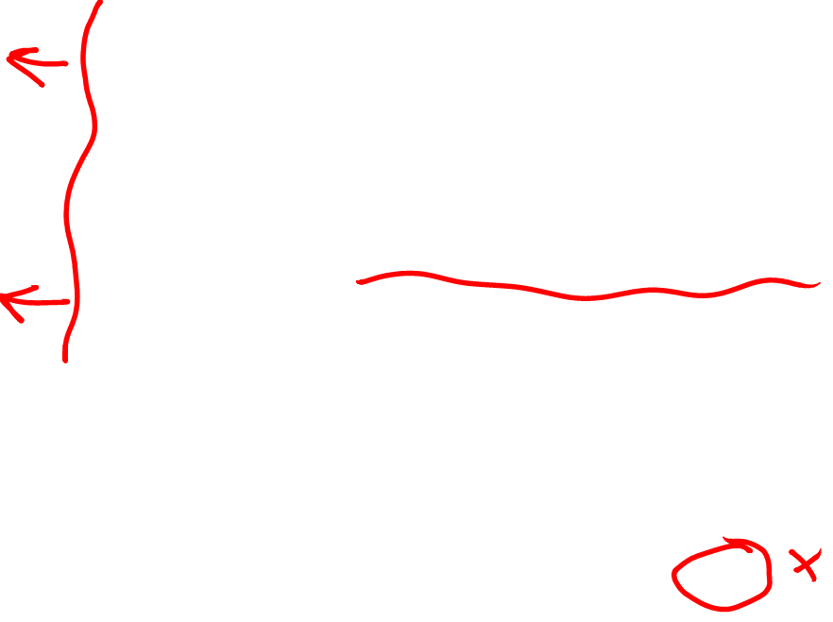
Belief Propagation
Pearl [1988]
Message m_{st} from s to t summarizes everything s knows except information obtained from t
("echo cancellation" EC)
s
m_{st}
t
Belief Propagation
Iterative approach that sends messages between nodes
Repeat until messages converge
Result is label distribution ("beliefs") at each node
0.1
0.8
0.1
b_{t}=
Problems on graphs with loops:
Approximation with no guarantees of correctness
Worse: algorithm may not even converge if graph has loops
Still widely used in practice
☹

Slide 6
Belief Propagation
Pearl [1988]
Weiss [Neural C.'00]
DETAILS
s
m_{st}
t
...
...
(1)
...
...
(2)
1) Initialize all message entries to 1
2) Iteratively: calculate messages for each edge and class
affinity
"echo cancellation" EC
explicit beliefs
3) After messages converge: calculate final beliefs

Slide 7
Belief Propagation
DETAILS
Illustration
(...)=
0
4
H=
0.1 | 0.9
0.9 | 0.1
s
m_{st}
t
...
...
(1)
...
...
3.6
0.4
0.9
0.1
(2)
m_{st} =
∝
1) Initialize all message entries to 1
2) Iteratively: calculate messages for each edge and class
affinity matrix
"echo cancellation" EC
0
2
1
2
=
0
4
explicit beliefs
component-wise multiplication
3) After messages converge: calculate final beliefs
Often does not converge
on graphs with loops
☹

Slide 8
Roadmap
1) Background: "BP"
Belief Propagation
2) Our solution: "LinBP"
Linearized Belief Propagation
3) Experiments & Conclusions

Slide 9
Key Ideas: 1) Centering + 2) Linearizing BP
Original Value
=
Center point
+
Residual
1
0.1 | 0.8 | 0.1
0.8 | 0.1 | 0.1
0.1 | 0.1 | 0.8
1/3 | 1/3 | 1/3
1/3 | 1/3 | 1/3
1/3 | 1/3 | 1/3
-0.23 | 0.46 | -0.23
0.46 | -0.23 | -0.23
-0.23 | -0.23 | 0.46
=
+
0.2
0.6
0.2
1/3
1/3
1/3
-0.13
0.26
-0.13
=
+
1.1
0.8
1.1
1
1
1
0.1
-0.2
0.1
=
+
2

Slide 10
Linearized Belief Propagation
DETAILS
EC
not linear
BP
☹
EC
linear
LinBP
☺
no more normalization necessary

Slide 11
Matrix formulation of LinBP
DETAILS
Update equation
s
t
t
t
t
t
←
+
s
−
←
+
⋅
⋅
−
⋅
⋅
final
beliefs
(n x k)
explicit
beliefs
graph
affinity
matrix
degree
matrix
EC
Closed form
EC
Convergence
Spectral radius of (...) < 1
Scale with appropriate ε:

Slide 12
Roadmap
1) Background: "BP"
Belief Propagation
2) Our solution: "LinBP"
Linearized Belief Propagation
3) Experiments & Conclusions

Slide 13
Experiments
1) Great labeling accuracy
(LinBP against BP as ground truth)
2) Linear scalability
(10 iterations)
42min
BP
precision
100k edges/sec
recall
LinBP
4sec
|
|
ρ
67M
LinBP & BP give similar labels
LinBP is seriously faster!
Reason: when BP converges, then our approximations are reasonable
Reason: LinBP can leverage existing optimized linear algebra packages

Slide 14
What else you will find in the paper and TR
Theory
  Full derivation
SQL (w/ recursion)
  Implementation with standard aggregates
Single-pass Belief Propagation (SBP)
  Myopic version that allows incremental updates
Experiments with synthetic and DBLP data set

Slide 15
Take-aways
Goal: propagate multi-class heterophily from labels
Problem: How to solve BP convergence issues ☹
Solution: Center & linearize BP ⇒ convergence & speed ☺
Linearized Belief Propagation (LinBP)
  Matrix Algebra, convergence, closed-form
  SQL (w/ recursion) with standard aggregates
Single-pass Belief Propagation (SBP)
  Myopic version, incremental updates
t
←
+
s
−
←
+
⋅
⋅
−
⋅
⋅
http://github.com/sslh/linBP/
Thanks ☺

Slide 16
BACKUP

Slide 17
More general forms of "Heterophily"
Potential (P)
 | 1 | 2 | 3
1 | 1 | 8 | 1
2 | 8 | 1 | 1
3 | 1 | 1 | 8
class 1
(blue)
class 2
(orange)
class 3
(green)
Class-to-class interaction
Affinity matrix (H)
 | 1 | 2 | 3
1 | 0.1 | 0.8 | 0.1
2 | 0.8 | 0.1 | 0.1
3 | 0.1 | 0.1 | 0.8
0.8
0.1
0.1
0.1
0.1
0.8

Slide 18
BP has convergence issues
DETAILED EXAMPLE
Edge potentials
Explicit beliefs
A
B
-3
H =
0.9 | 0.1
0.1 | 0.9
e_{A}=e_{B}=
0.9
0.1
2
1
2
Edge weights
Nodes w/o priors:
3
3
C
D
H_{ij}'∝ H_{ij}^{w}
0.5
0.5
e_{C}=e_{D}=
BP
BP with damping=0.1
C
0.94
A
0.51
0.59
0.48
1) no guaranteed converge
2) damping: many iterations

Slide 19
BP has convergence issues
DETAILED EXAMPLE
Edge potentials
Explicit beliefs
A
B
-3
H =
0.9 | 0.1
0.1 | 0.9
e_{A}=e_{B}=
0.9
0.1
2
1
2
Edge weights
Nodes w/o priors:
3
3
C
D
H_{ij}'∝ H_{ij}^{w}
0.5
0.5
e_{C}=e_{D}=
BP
BP with different parameters
BP with damping=0.1
C
0.94
A
0.51
0.59
0.48
1) no guaranteed converge
3) unstable fix points possible

Slide 20
LinBP can always converge
DETAILED EXAMPLE
Edge potentials
Explicit beliefs
A
B
-3
H =
0.9 | 0.1
0.1 | 0.9
e_{A}=e_{B}=
0.9
0.1
2
1
2
Edge weights
Nodes w/o priors:
3
3
C
D
H_{ij}'∝ H_{ij}^{w}
0.5
0.5
e_{C}=e_{D}=
LinBP with (ε/ε_{conv}) = 0.1
BP
C
0.94
0.85
A
0.53
0.51
LinBP: guaranteed converge
1) no guaranteed converge

Slide 21
LinBP in SQL

Slide 22
Single-Pass BP: a "myopic" version of LinBP
v₂
v₄
v₂
v₄
g=1
v₁
v₁
g=2
v₅
v₅
v₃
v₃
v₆
v₆
v₇
v₇

Slide 23
POSTER

Slide 24

?
?
?
Linearized and
Single-Pass
Belief Propagation
?
?
?
?
?
?
Wolfgang Gatterbauer, Stephan Günnemann¹, Danai Koutra², Christos Faloutsos
VLDB 2015
Carnegie Mellon
Database Group
¹ Technical University of Munich
² University of Michigan

Slide 25
"Birds of a feather..."
(Homophily)
"Opposites attract"
(Heterophily)
?
Leader
Follower
?
Political orientation
Leader
"Guilt-by-association"
recommender systems
semi-supervised learning
random walks (PageRank)
Disassortative networks
biological food web
protein interaction
online fraud settings
Affinity matrix (also potential or heterophily matrix)
 | 1 | 2
1 | 0.8 | 0.2
2 | 0.2 | 0.8
 | 1 | 2
1 | 0.2 | 0.8
2 | 0.8 | 0.2
H =
H =

Slide 26
More general forms of "Heterophily"
Potential (P)
 | 1 | 2 | 3
1 | 1 | 8 | 1
2 | 8 | 1 | 1
3 | 1 | 1 | 8
class 1
(blue)
class 2
(orange)
class 3
(green)
Class-to-class interaction
Affinity matrix (H)
 | 1 | 2 | 3
1 | 0.1 | 0.8 | 0.1
2 | 0.8 | 0.1 | 0.1
3 | 0.1 | 0.1 | 0.8
0.8
0.1
0.1
0.1
0.1
0.8

Slide 27
The problem we are trying to solve
?
?
?
 | 1 | 2 | 3
1 | 0.1 | 0.8 | 0.1
2 | 0.8 | 0.1 | 0.1
3 | 0.1 | 0.1 | 0.8
?
?
H =
?
?
?
k=3 classes
?
Problem formulation
Given:
undirected graph G
seed labels
affinity matrix H
(symmetric, doubly stoch.)
Good: Graphical models
can model this problem
☺
Bad: Belief Propagation
on graphs with loops
has convergence issues
☹
Find:
remaining labels

Slide 28
Markov networks (also Markov Random Fields)
"Misconception example"
Koller,Friedman[2009]
Alice
Bob
Does a student think + or -?
B\C | + | -
+ | 0.9 | 0.1
- | 0.1 | 0.9
Bob and Charlie tend to agree (homophily)
H_{BC} =
Debbie
Charlie
C\D | + | -
+ | 0.1 | 0.9
- | 0.9 | 0.1
Charlie and Debbie tend to disagree (heterophily)
H_{CD} =
Inference tasks
Marginals (belief distribution)
Maximum Marginals (classification)
+ | 0.6
- | 0.4
b_{D} =
Maximum
Marginal
☹
But Inference is typically hard

Slide 29
Belief Propagation
DETAILS
Illustration
2
0
0
0.1 | 0.8 | 0.1
0.8 | 0.1 | 0.1
0.1 | 0.1 | 0.8
(...)=
H=
s
m_{st}
t
0.2
1.6
0.2
0.1
0.8
0.1
m_{st} =
∝
1) Initialize all message entries to 1
2) Iteratively: calculate messages for each edge and class
multiply messages from all neighbors except t
("echo cancellation" EC)
edge potential
EC
explicit (prior) beliefs
componentwise-multiplication operator
3) After messages converge: calculate final beliefs
Does often not converge
on graphs with loops
☹

Slide 30
Illustration of convergence issue with BP
Edge potentials
Explicit beliefs
A
B
-3
H =
0.9 | 0.1
0.1 | 0.9
e_{A}=e_{B}=
0.9
0.1
2
1
2
Edge weights
Nodes w/o priors:
3
3
C
D
H_{ij}'∝ H_{ij}^{w}
0.5
0.5
e_{C}=e_{D}=
BP
BP with damping=0.1
Different parameters
0.94
0.51
0.59
0.48
1) no guaranteed
convergence
2) damping:
many iterations
3) BP can have
unstable fix points

Slide 31
Properties of "Linearized Belief Propagation"
Linear
Algebra
RWR,
SSL
LinBP
Improved
computational
properties
Iterative
BP
homoph.
heteroph.
LinBP properties:
Heterophily
Matrix Algebra
Closed form
convergence criteria
SQL with recursion
Expressiveness

Slide 32
Key Idea: Centering + Linearizing BP
Original Value
=
Center point
+
Residual
0.1 | 0.8 | 0.1
0.8 | 0.1 | 0.1
0.1 | 0.1 | 0.8
1/3 | 1/3 | 1/3
1/3 | 1/3 | 1/3
1/3 | 1/3 | 1/3
-0.23 | 0.46 | -0.23
0.46 | -0.23 | -0.23
-0.23 | -0.23 | 0.46
=
+
0.2
0.6
0.2
1/3
1/3
1/3
-0.13
0.26
-0.13
=
+
1.1
0.8
1.1
1
1
1
0.1
-0.2
0.1
=
+

Slide 33
Linearized Belief Propagation
DETAILS
EC
not linear
BP
☹
EC
linear
LinBP
☺
Messages remain centered !

Slide 34
Matrix formulation of LinBP
DETAILS
Update equation
s
t
t
t
t
t
←
+
s
−
←
+
⋅
⋅
−
⋅
⋅
final
beliefs
(n x k)
explicit
beliefs
graph
affinity
matrix
degree
matrix
EC
Closed form
EC
Convergence
Spectral radius of (...) < 1
Scale with appropriate ε:

Slide 35
Experiments
1) Great labeling accuracy
(LinBP against BP as ground truth)
2) Linear scalability
(10 iterations)
42min
BP
precision
100k edges/sec
recall
LinBP
4sec
|
|
ρ
67M
LinBP & BP give similar labels
LinBP is seriously faster!
Reason: when BP converges, then our approximations are reasonable
Reason: LinBP can leverage existing optimized matrix multiplication

Slide 36
LinBP in SQL

Slide 37
Single-Pass BP: a "myopic" version of LinBP
v₂
v₄
v₂
v₄
g=1
v₁
v₁
g=2
v₅
v₅
v₃
v₃
v₆
v₆
v₇
v₇

Slide 38
Take-aways
Goal: propagate multi-class
heterophily from labeled data
Problem: How to solve the
convergence issues of BP ☹
Solution: Let's linearize BP to
make it converge & speed it up ☺
Linearized Belief Propagation (LinBP)
  Matrix Algebra, convergence, closed-form
  SQL (w/ recursion) with standard aggregates
Single-pass Belief Propagation (SBP)
  Myopic version, incremental updates
Come to our talk on Wed, 10:30 (Queens 4) ☺

